Slide 1
Applying Earned Value Management to Agile Software Development Programs
Bob Hunt
Michael Thompson
Gordon Kranz
Galorath Federal Incorporated

Slide 2

Agenda
Background to Agile
Agile/Hybrid Agile software development implementation
Establishing a process for developing the technical, cost and schedule baseline
Applying Earned Value Management to Agile Programs
Summary
Back Up

Slide 3

How Formal Is Agile?
Manifesto for Agile Software Development
“We are uncovering better ways of developing
software by doing it and helping others do it.
Through this work we have come to value:
Individuals and interactions over processes and tools
Working software over comprehensive documentation
Customer collaboration over contract negotiation
Responding to change over following a plan
That is, while there is value in the items on
the right, we value the items on the left more.”
Agile is NOT a Method – it’s a mindset!
Individual Methods are Formal – sort-of

Slide 4
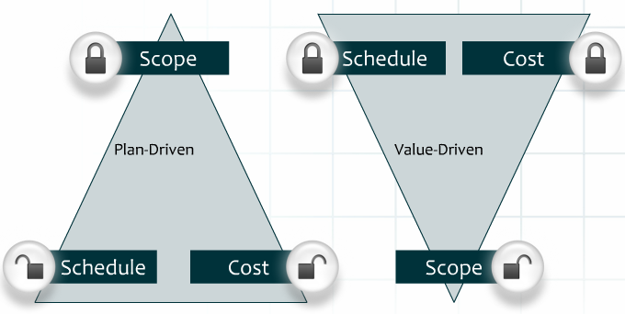
Agile 101 – How It Works
Agile is a set of software development methods in which solutions evolve through collaboration
  Integrated teams include PeopleSoft SMEs to configure the product, PeopleSoft Developers, Data Integration Developers, and Testers
Development is iterative
  The traditional software development phases are seen as continuous activities
  Work is broken into smaller tasks
  Multiple iterations may be required to release a product
  Documentation is created as-built
For each iteration, a working product is demonstrated to stakeholders
Emphasizes value-driven approach
  The usual project constraints still apply
  Focusing on value allows most important
  functionality to be delivered first
Technology agnostic

Slide 5
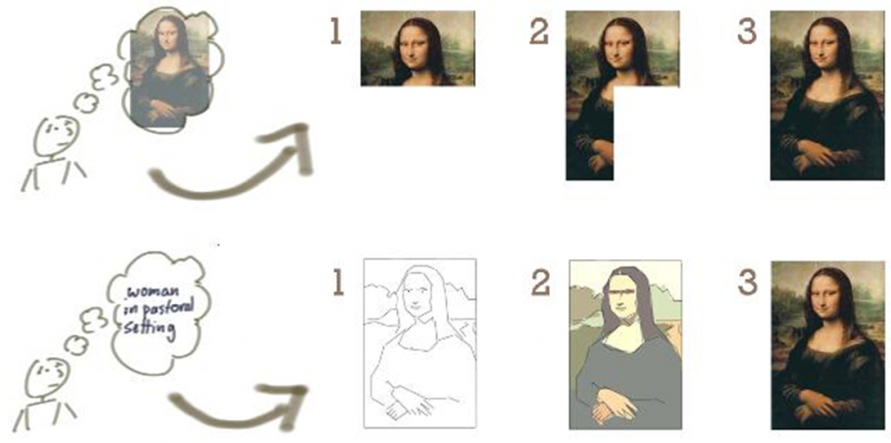
Agile 101 – Development Approach Metaphor
The waterfall approach is akin to painting by numbers, as it calls for a fully formed idea at the start, which is built incrementally, piece by piece without flexibility
With Agile, we start with a concept: for several large software development programs, the COTS product is the starting point
Then, we iteratively build a rough version and validate it, slowly improving the definition and quality

Slide 6
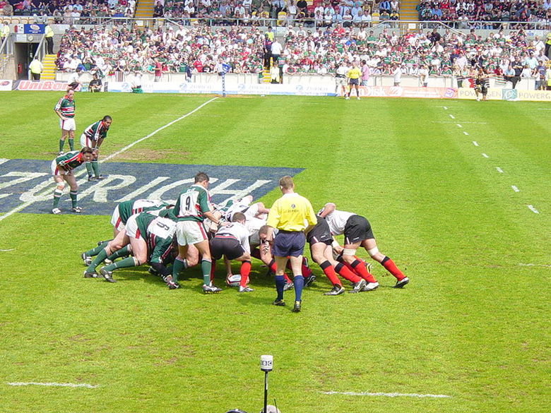
Agile 101 – Key Agile Terminology
Term | Definition
Scrum | A framework for team collaboration on complex software projects. 1-10 people (have seen up to 20)
Sprint | A short multiple-week period where a team completely builds working, tested software. All phases of the SDLC are executed iteratively during a sprint – Analysis, Design, Code, Test. 1-6 weeks (have seen up to 13 weeks) (13 conveniently give 4 sprints per year)
Feature | A set of specifications that can be shown in a user demonstration and oriented on system capabilities.
Epic | A description of how work gets done using the new software (To-Be business process).
Spike | A special type of story used for research and prototyping activities, which can be functional or technical.
Backlog | A single definitive repository for all upcoming work. It consists primarily of future features intended to address user needs and deliver business benefits, as well as architectural features required to build the product.

Slide 7
Agile Implementation
To create working software product often and to demonstrate to the customer
Sprint Backlog
Sprint Burndown
Impediment List
Sprint Planning Meeting
Daily Scrum/
Daily Work
Scrum Process
Backlog
Update Product Backlog
Sprint Review
Demonstration
Sprint
Retrospective
Product
Increment
Feature/BP Demonstrations
Ensures holistic activities and iterative processes
7
INTEGRITY INNOVATION EXCELLENCE

Slide 8
Agile 101 – Sprint Breakdown
Sprint Planning Meeting
  Product owner and scrum team meet at the start of the sprint to review the sprint goal, and select the requirements/features and corresponding tasks to be accomplished.
Daily Scum/Daily Work
  Scrum team meets daily to review yesterday’s accomplishments, plan for today, and any blockers.
Sprint Review Demonstration
  Scrum team demonstrates sprint accomplishments (requirements and/or features implemented during that sprint) to the product owner.
Sprint Retrospective
  The scrum team meets to discuss what to keep doing, stop doing, and start doing. Focus on what is actionable for the next sprint.
Update Product Backlog
  The product owner continuously updates (adds to, reprioritizes, etc.) the product backlog.
Sprint Planning Meeting
Daily Scrum/
Daily Work
Sprint Backlog
Sprint Burndown
Impediment List
Scrum Process
Update Product Backlog
Sprint Review
Demonstration
PDR/CDR/TRR
Sprint
Retrospective
Product
Increment

Slide 9
Agile 101 – Recap
Agile is a disciplined methodology.
Agile is not…
  …unlimited or uncontrolled scope.
  …unplanned.
  …undocumented.
  …unverified.
  …mini waterfall.
  …trial and error.
  …a synonym for flexible.
  …a synonym for fast.

Slide 10
Agile 101 - Summary
Waterfall faces challenges in a large-scale ERP implementation.
  Significant effort to build and maintain momentum
  High risk of a resulting product that does not meet needs
Looking for an alternative:
  Best candidate is Scaled Agile Framework (SAFe)
  Lower risk implementation
  Produces better results, meets large software program’s vision
  Allows us to confirm that we are building the right thing
  Gets early buy-in
  Reduces the risk of rework when it is too late and more costly to change
  Improved understanding of progress and cost
Better software development process, better user experience:
  Break work into smaller, more manageable segments
  Measure progress based on working software product
  Drive functionality working on through to completion
  Emphasize showing working versions of product early and often to validate
  Use product to review whether it meets requirements – shift to As-Built documentation
  Use government time and resources better by reviewing software, not paper
  Use cumulative assembly testing for earlier validation of product
  Have automated regression test bed available on go-live

Slide 11
Agile Building Blocks*
Release 1 (made up of multiple Themes/Increments
Theme/Increment 1
Feature Point values applied to each Feature
EVM work Packages identified at Epic or Theme level
Epic 1
Feature 1
User Story 1
Epic 2
Feature 2
User Story 2
Epic 2 Feature 3
User Story 3
Sprints
Cost Estimating done at the Sprint Level
* These “building blocks” are program specific and may be called by different names

Slide 12
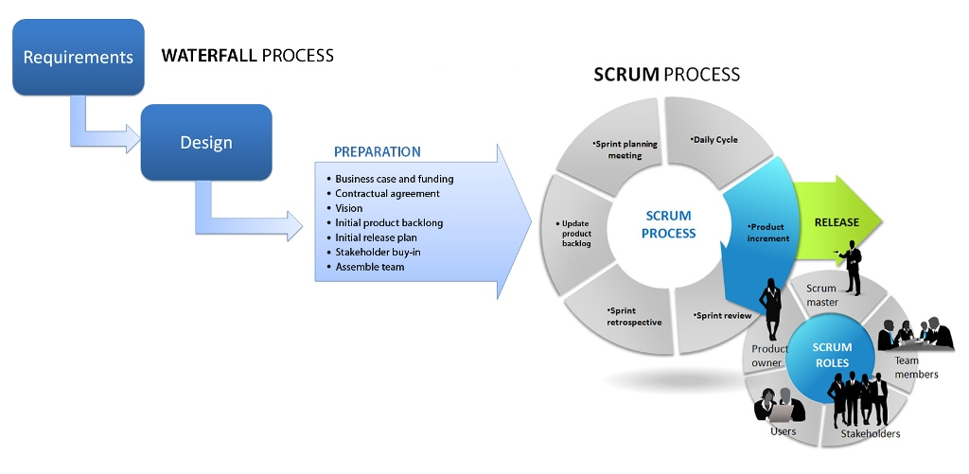
Hybrid Agile Development/Acquisition
Agile
Testing and Sustainment ?

Slide 13
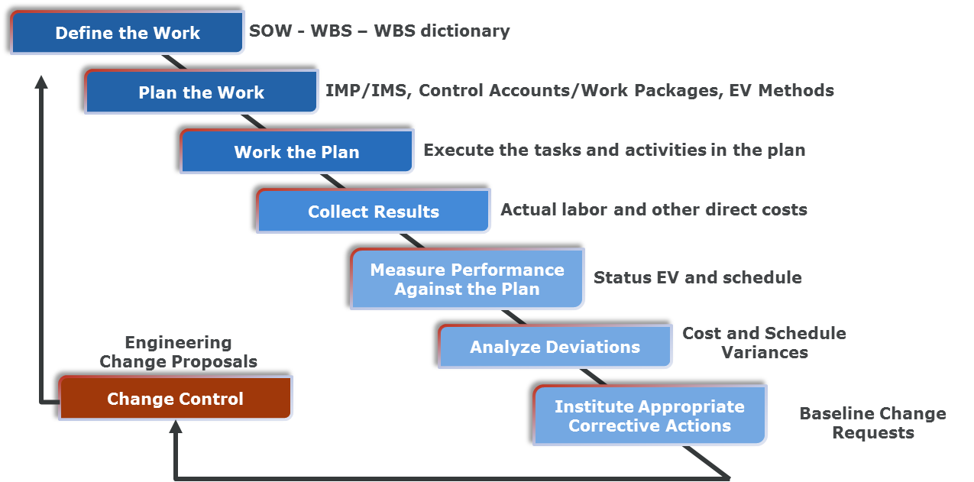
Earned Value Management Process

Slide 14
Where Does EVM fit in?
As long as there is a plan and product, which can be measured EVM can be used
The product backlog defines the product, and sprints are used to time phase the work.
Status of each Sprint is rolled up at the EPIC Level, which in this example is the Control Account (CA)
  Below the EPIC is the Feature at the Work Package (WP) level, which breaks the EPIC into functional packages
  Features are decomposed into Stories and Story points
  Sprints are statused by, in this case, Stories and Story Points, which are maintained in an Agile Program Management Tool
As Features are completed the percent complete is rolled up to the EPIC level

Slide 15
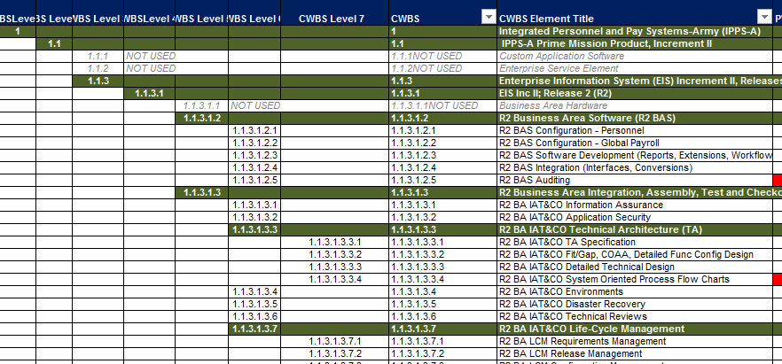
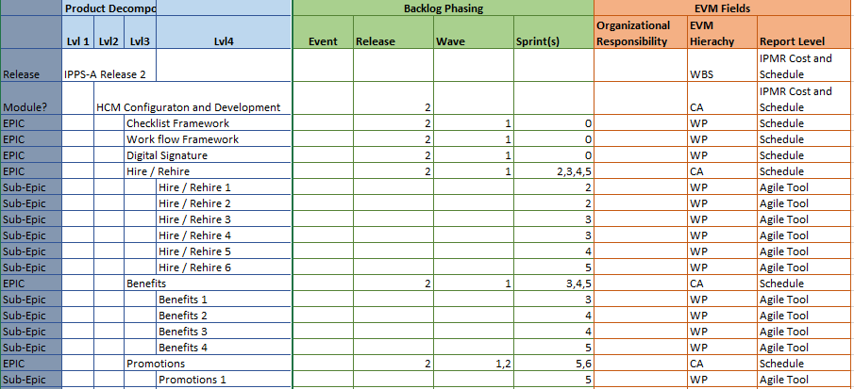
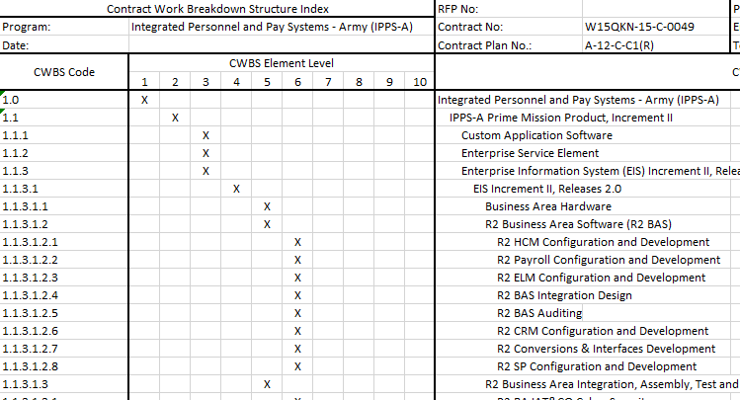
Documentation Traceability
Contractor CWBS Matrix
CSDR CWBS Matrix

Slide 16
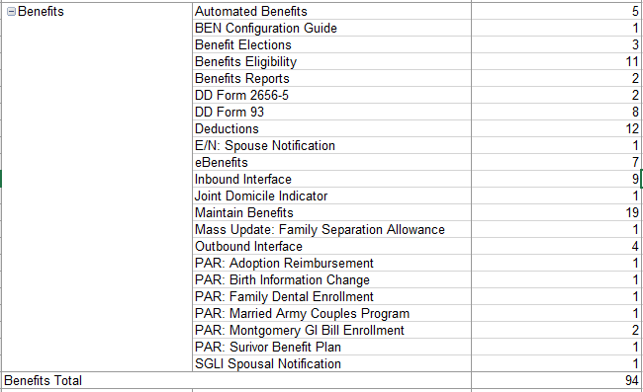
EVM – Agile Traceability
# of SSS Requirements
Epics
Features
Which Features are mapped to which Sub-
EPIC (WP)
Initial Features Priorities & LOE. Xls

Slide 17
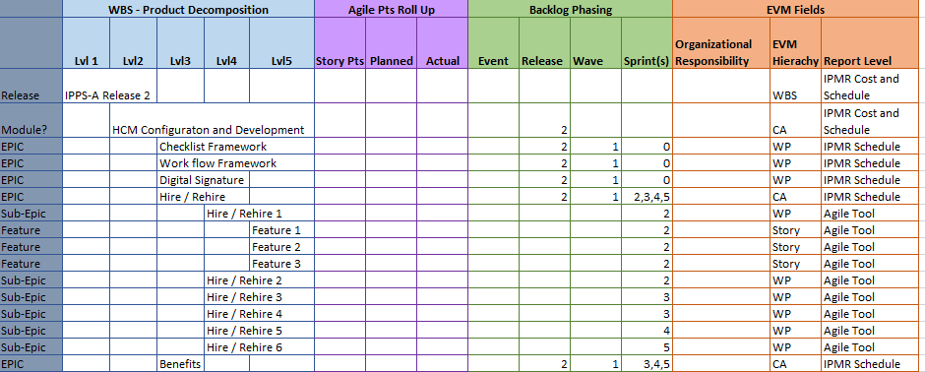
Progress Roll Up
Earned Value Taken at the EPIC Level
Progress at EPIC Level Rolled into EVM Progress
EPICS lowest level in the schedule
EVM Progress tracked in schedule at EPIC Level
EPIC Progress Rolled up Module Status
AGILE Tool Provides Sprint Status
Story Points Assigned Feature Level
Sub-EPIC and Feature Completion
Rolled up to EPIC Level

Slide 18
Approach Allows Following Progress Reports
Earned Value Status at EPIC Level
Progress against
  % EPIC Completion
  % Module Completion
  % Feature Completion Total
  % SSS Completion
Metrics and Trends
  Feature Burn Down / Up
  EPIC Burn Down / Up
  SSS Burn Down / Up
  Sprint Velocity by Team and over time
Supports EAC Development from a variety of angles for cross verification

Slide 19
Notional Sprint Data

Slide 20
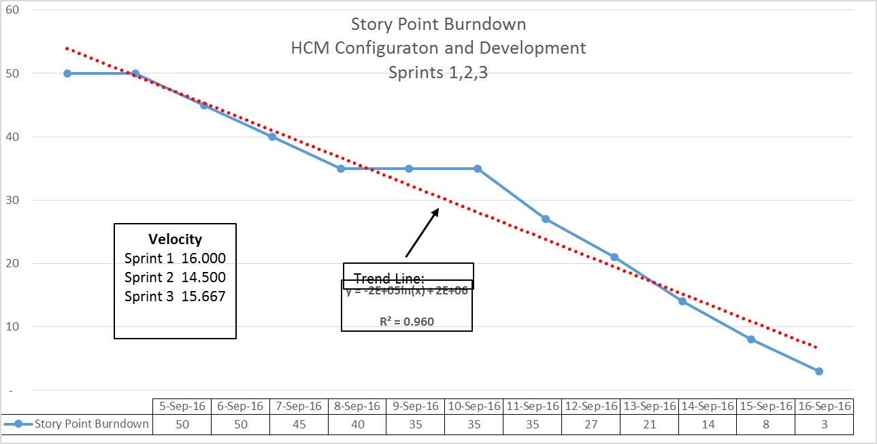
Notional Story Point Burndown Chart

Slide 21
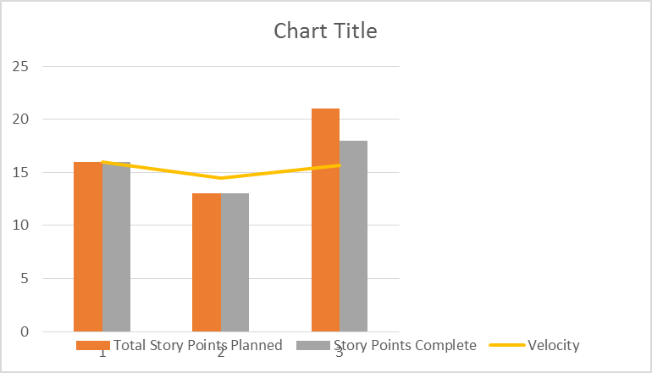
Notional Sprint Burndown Bar Chart

Slide 22
Summary
Fixed Price and/or LOE contracts in the early phases should be written so that key “value-added” metrics are collected and reported during each increment
Estimators may have to employ a variety of software estimating methodologies within a single estimate to model the blended development approaches being utilized in today’s development environments
    An agile estimating process can be applied to each iteration/sprint
    Future Increments can be estimated based on most recent/successful IID performance
Cost estimators will have to scrutinize these programs like a schedule analyst might to determine the most likely IOC capabilities and associated date
    The number of increments are an important cost driver as well as an influential factor in uncertainty/risk modeling

Slide 23
Summary
All of the estimation methods are susceptible to error, and require accurate historical data to be useful within the context of the organization
When developers and estimators use the same “proxy” for effort, there is more confidence in the estimate

Slide 24
Recommended Reading
“The Death of Agile” blog
“Agile Hippies and The Death of the Iteration” blog
Story Point Inflation
5

Slide 25
Endnotes
1, 2, 4, 10, 11: Larman, C. (2010). Agile and Iterative Development: A Manager's Guide.
3: Kilgore, J. (2012). Senior Associate, Kalman & Company, Inc.
5, 6, 7, 8: Agile Alliance. (2012). Agile Alliance. Retrieved 2012, from http://www.agilealliance.org
9: Coaching, T. L. (n.d.). Rally Software Scaling Software Agility.
12: Bittner, K., & Spence, I. (2006). Managing Iterative Software Development Projects. Addison-Wesley Professional.

Slide 26
Additional References
Cohn, M. (2009). Succeeding with Agile Software Development using Scrum.
Dooley, J. (2011). Software Development and Professional Practice.
Gack, G. (2010). Managing the Black Hole.
George, J., & Rodger, J. (2010). Smart Data (Enterprise Performance Optimization Strategy).
Royce, W., Bittner, K., & Perrow, M. (2009). The Economics of Iterative Software Development: Steering Towards Better Business Results. Addision Wesley Professional.
Smith, G., & Sidky, A. (2009). Becoming Agile in an Imperfect World.
5

Slide 27
Contact Information
Bob Hunt
    Email: BHunt@Galorath.com
    Phone: 703.201.0651
  Mike Thompson
    Email: mthompson@galorath.com
    Phone: 301.904.1103
  Gordon Kranz
    Email: gmkranz@eipm-llc.com
    Phone: 571.268.8168

Slide 28
Back Up

Slide 29
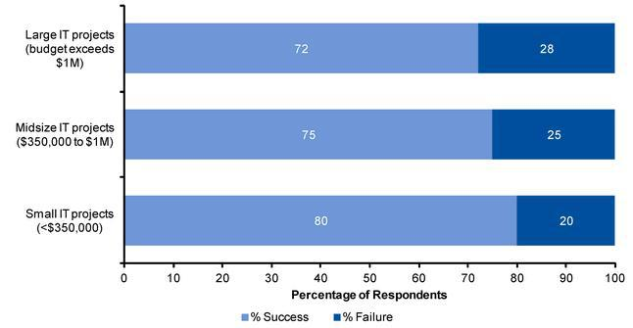
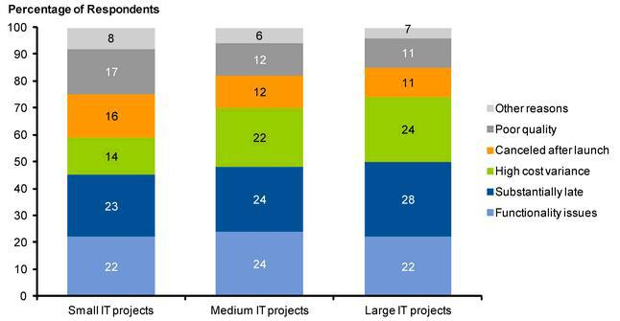
IT Project Success
20% to 30% Failures
Figure 1. Distribution of Success and Failure Across Project Sizes
Source: Gartner (June 2012)
Why they fail

Slide 30
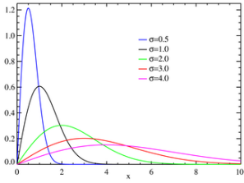
Five Estimating Methodologies
Methodology 1: Since many Agile programs are fixed price, it is often just a matter of labor rates times quantity
Methodology 2: Simple Build-up approach based on averages can be defined as:
    Sprint Team Size (SS) x Sprint length (Sp time) x Number of Sprints (# Sprints)
    Methodology 3: Structured approach based on established “velocity” – most often used internally by the developer since detailed/sensitive data are available to them
    Methodology 4: Automated Models approach based on a size metric – which may be difficult to quantify
    Methodology 5: Factor/Complexity approach based on data generated in early iterations

Slide 31
What to measure

Slide 32
Software Development
While there are many approaches to Software Development, they can generally be placed into 2 categories:
    Plan Driven – following a version of the Waterfall Development Process
    Iterative Driven – following a “version” of the Agile Development Process
  Plan Drive programs have an assumption of some reliable/realistic size metric, for example:
    Source Lines of Code (SLOC)
    Function Points
    Use Cases, User Stories, Web Pages

Slide 33
What is Agile Software Development?
In the late 1990s, several methodologies received increasing public attention
Each had a different combination of old, new, and transmuted old ideas, but they all emphasized:
    Close collaboration between the programmer and business experts
    Face-to-face communication (as more efficient than written documentation)
    Frequent delivery of new deployable business value
    Tight, self-organizing teams
    And ways to craft the code and the team such that the inevitable requirements churn was not a crisis
5

Slide 34
Agile – System View
Release 1.0
Release 2.0
Release 3.0
Legacy System Sunset Order
Full Application Fit/Gap
R2 PDR
R2 CDR
R2 PBR
R3 PDR
R3 CDR
R3 PBR
R5 PDR
R5 CDR
R5 PBR
Delta Fit/Gap
Delta Fit/Gap
Epic
Epic
Epic
Epic
Epic
Epic
Epic
Epic
Epic
Epic
Epic
Epic
Epic
Epic
Epic
Epic
Epic
Epic
Epic
Epic
Epic
Epic
Epic
Epic
Epic
Epic
Epic
Personnel
Epic
Application Development
Cumulative/Regression Personnel PLT
AGILE TERRITORY
R2 RRE Prep
R3 RRE Prep
R4 PDR
R4 CDR
R4 PBR
Spike
Spike
Spike
Spike
Spike
Spike
Spike
Spike
Pay
Epic
Epic
Epic
Epic
Epic
Epic
Epic
Epic
Epic
Epic
Epic
Epic
Epic
Epic
Epic
Epic
Epic
Epic
Epic
Epic
Epic
Epic
Epic
Epic
Epic
Epic
Epic
Epic
Cumulative/Regression Pay PLT
Data
SI Tools Fit/Gap
R2 PDR
R2 CDR
R2 PBR
R3 PDR
R3 CDR
R3 PBR
R5 PDR
R5 CDR
R5 PBR
Prelim Data Maps
Final Data Maps
Build
Prelim Data Maps
Final Data Maps
Build
Prelim Data Maps
Final Data Maps
Build
R4 PDR
R4 CDR
R4 PBR
Prelim Data Maps
Final Data Maps
Build
WATERLINE
NON-AGILE
Cybersecurity
Environments Systems Management
Infrastructure
Configuration Management
Systems Engineering
Auditing
Lifecycle Management
Integrated Logistics Support
Government Testing
DEVELOP ON CADENCE, RELEASE ON DEMAND

Slide 35

Agile Release and Sprint Backlog
Product Backlog
Agile methods can start earlier in the process because we are starting with a COTS product baseline.
Increasing use of Agile Methods
Analyze
Design
Test
Configure
Analyze
Design
Test
Configure
Analyze
Design
Test
Build
Analyze
Design
Test
IBR
F/G
TRR
Preliminary Design Planning
Conduct Fit/Gap Build
Release Backlog
Conduct Framework Build
Conduct High/Medium Priority Build
Conduct Low Priority Build
Feature Backlog
Sprint Backlogs
Feature 1
Feature 1, Sprint 1
Feature 2, Sprint 1
Feature 4, Sprint 1
Feature 2
Feature 3, Sprint 1
Feature 2, Sprint 2
Feature 4, Sprint 2
Feature 3, Sprint 2
User Feedback,
Defects, and New Features
Feature n…

Slide 36
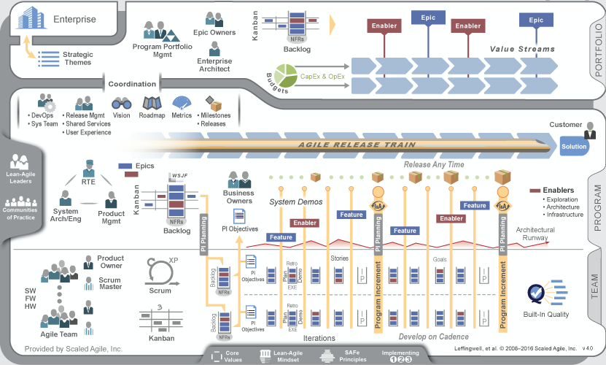
How to Scale
Agile methods are generally used for projects of smaller scope.
Scaled Agile Framework (SAFe) builds from Agile methods to provide a construct for large-scale implementations.
A playbook tailored to particular software program will inform the development of the IMS and form the basis to guide teams.
  Introduces features to bridge the gap between epics (business processes) and sprints.
  Introduces spikes to explore various approaches to address key foundational decisions.
INTEGRITY INNOVATION EXCELLENCE 36

Slide 37
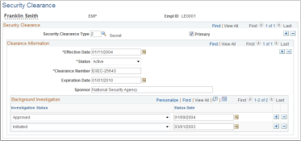
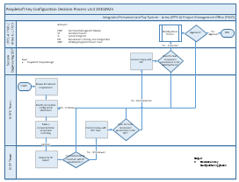
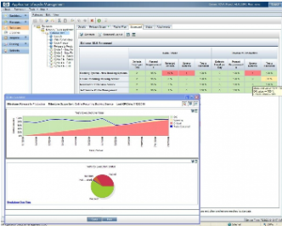
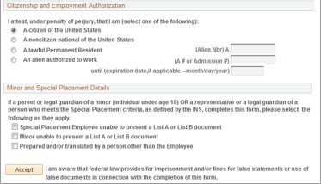
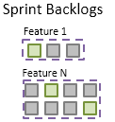
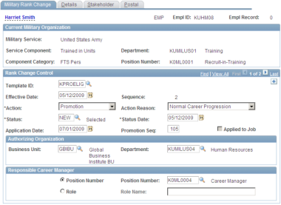
How to Define Work
.
1 - Requirements are defined based on the Business Process.
2 - Requirements are grouped into features aligned with the delivered software product.
3 - Features are decomposed into tasks to be executed in sprints.
Features will be classified as one of the following types:
  Framework: Foundational capabilities that need to be completed early as they will be leveraged throughout the solution.
  Core: Capabilities support transactional processing. These include setup tables that maintain valid values and capabilities to manage employee records.
  Self-Service: Any feature that has a self-service component is identified.
  Information: Reports, queries, dashboards.
  Data: Conversions and interfaces.

Slide 38
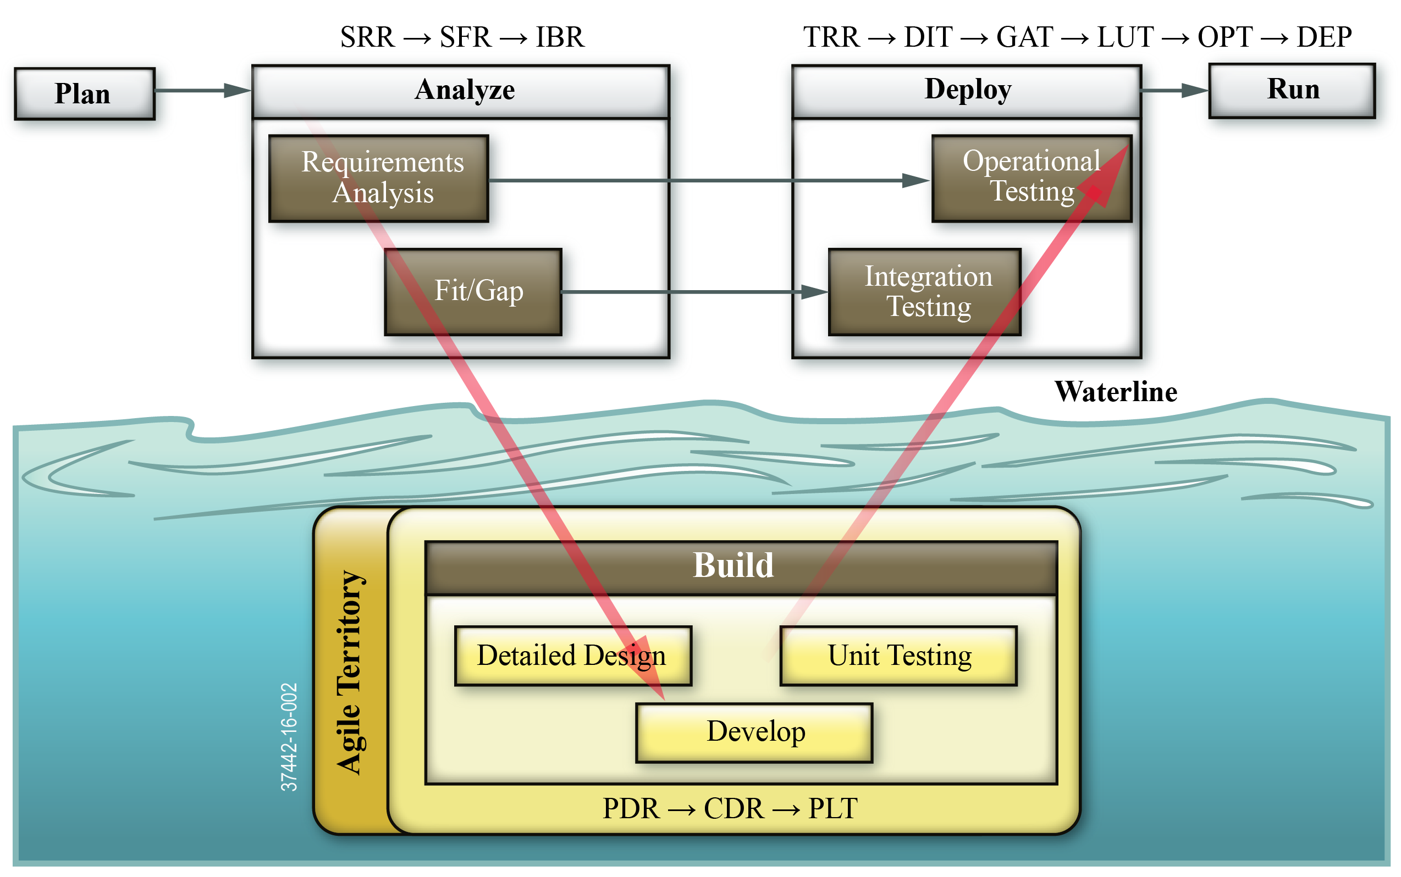
How to Apply Agile in a Non-Agile World
38

Slide 39
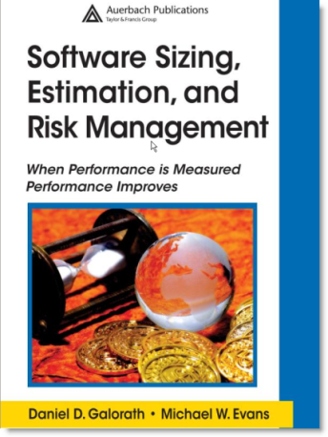
Galorath: Driving The State of the Art
(10 Step Estimation Process)
When performance is measured performance improves
Estimation processes are independent of tools
Establish Estimate Scope
Track Project Throughout Development
Document Estimate and Lessons Learned
Establish Technical Baseline, Ground Rules, Assumptions
Generate a Project Plan
Collect Data
Quantify Risks and Risk Analysis
Estimate and Validate Software Size
Review, Verify and Validate Estimate
We will use these 10 steps in our Estimation Process Improvement Program (EPIP)
Prepare Baseline Estimates

Slide 40
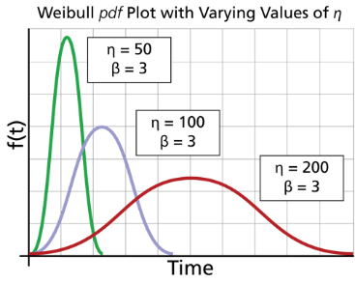
Fundamental Model Assumptions
Fundamental assumptions of most Software Estimating Models
There is a fixed relationship between size and effort, e.g.
  (Effort**n)*Time = Size/Technology
Results are then modified by current trends and analyses
Total effort can be distributed by a mathematical model; e.g. Weibull, Rayleigh

Slide 41
Methodology 5: Factor/Complexity Approach
Scale | Functional Description | Effort Multipliers
- - - | Significantly less functionality to be delivered | 0.5
- - | Moderately less functionality to be delivered | 0.7
- | Slightly less functionality to be delivered | 0.9
= | Functionality equivalent to Increment X | 1.0
+ | Slightly more functionality to be delivered | 1.3
+ + | Moderately more functionality to be delivered | 1.7
+ + + | Significantly more functionality to be delivered | 2.0
Scale | Complexity Description | Effort Multipliers
- - | Significantly less complex | 0.7
- | Slightly less complex | 0.9
= | Complexity equivalent to Increment X | 1.0
+ | Slightly more complex | 1.3
+ + | Significantly more complex | 1.7
  These initial set of factors came from the environmental factor from traditional software cost models
    Because each Increment is a mini project, use a Rayleigh or simple Beta Curve (such as a 60/50 Beta curve) to phase costs

