Slide 1

Naval Center for Cost Analysis (NCCA)
Modeling with Gumby:
Pros and Cons of the Weibull Curve
Jake Mender and Ann Hawpe
18 MAY 2017
Notes:
1

Slide 2


Overview
Motivation
Parametric Phasing Curve Overview
Overfitting
Rayleigh Function Details
Rayleigh vs. Weibull
Problem with Rayleigh
Solutions
Take Aways
Future Study

Slide 3
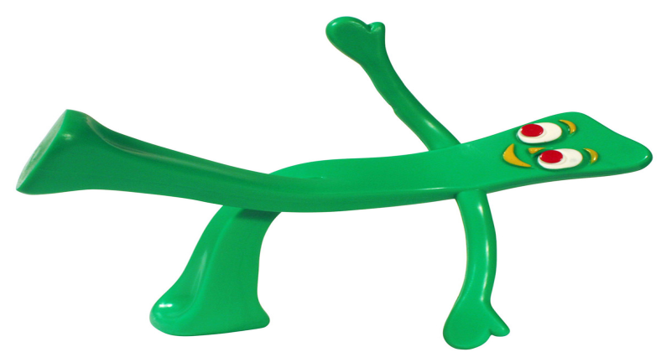
Motivation
NCCA was asked to evaluate the use of the Weibull curve, instead of the commonly used Rayleigh curve, as a tool for early R&D project estimating
Our review highlighted some potential pitfalls when using the Weibull for predictive purposes with small data sets
Results are relevant to other modeling problems in the cost estimating domain

Slide 4
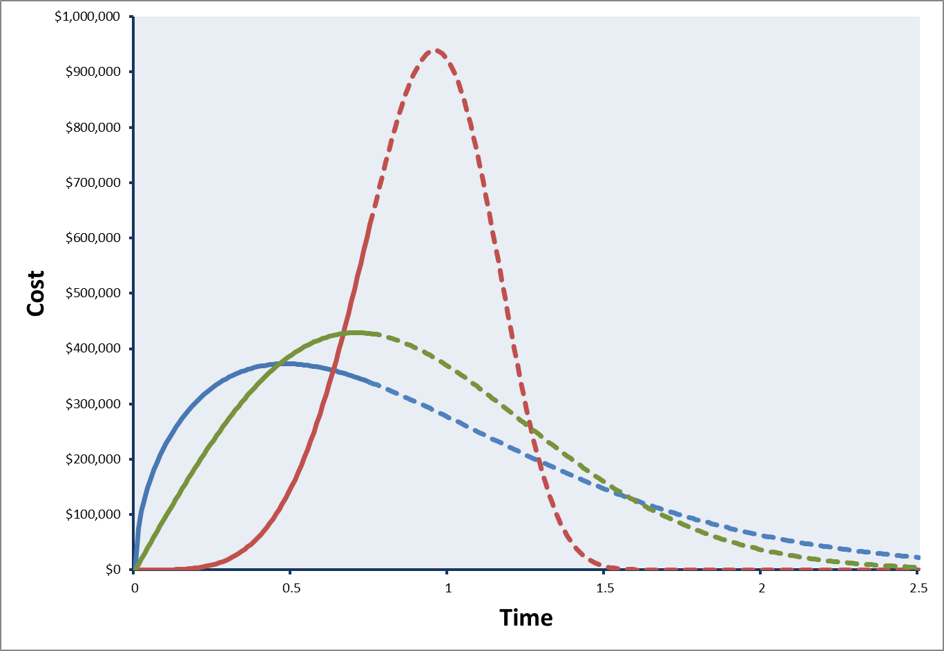
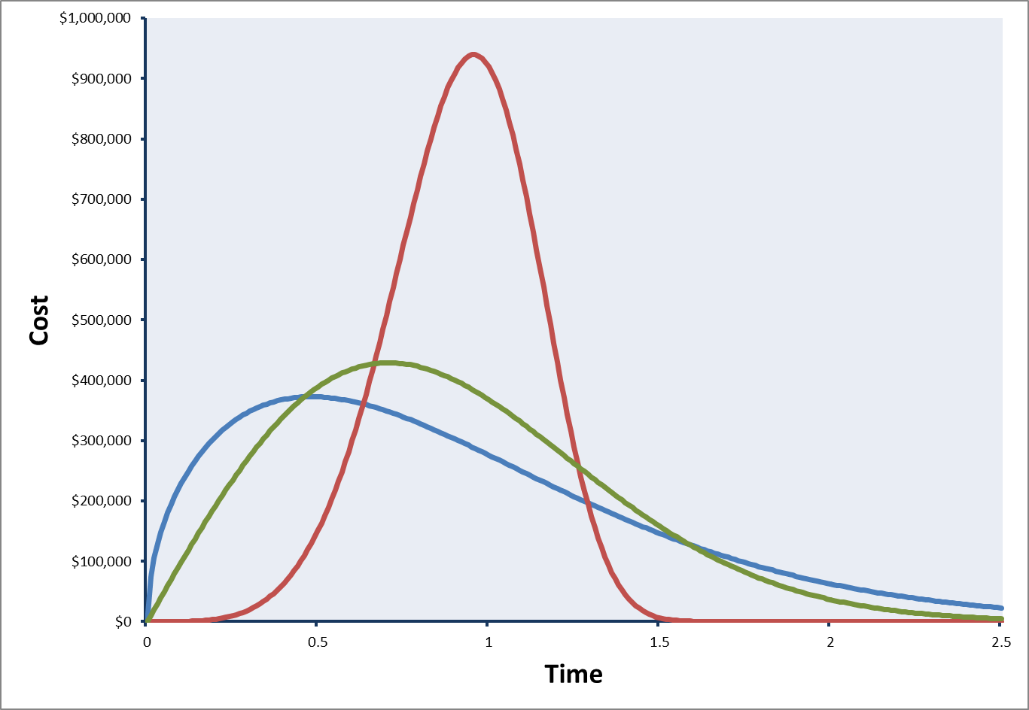
Parametric Phasing Curves
Functions that give cost, hours, or effort as a function of time elapsed
Allows for a forecast of effort and schedule to-go by fitting the chosen function to actuals to-date (by period)
Useful when estimating cost or schedule independent of Program Manager projections

Slide 5
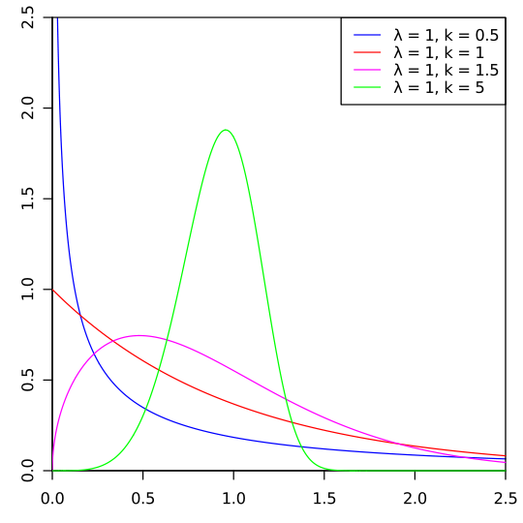

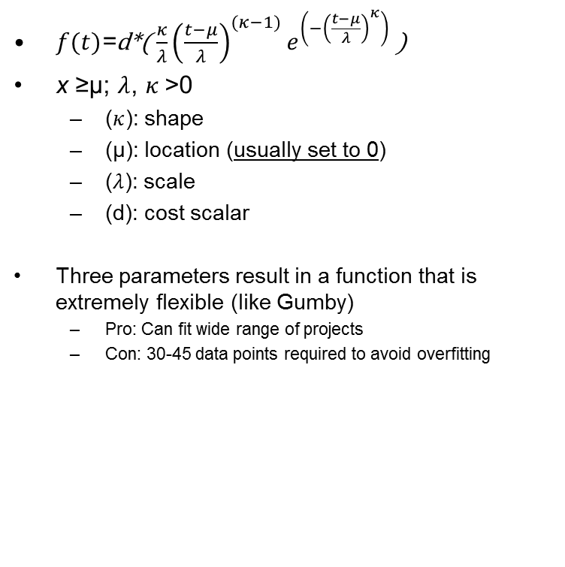
Weibull Distribution
$f(t)$=d*( $\frac{κ}{λ}{\left(\frac{t−μ}{λ}\right)}^{(κ−1)}e^{\left(−{\left(\frac{t−μ}{λ}\right)}^{κ}\right)}$ )
x ≥μ; $λ$, $κ$>0
  ($κ$): shape
  (μ): location (usually set to 0)
  ($λ$): scale
  (d): cost scalar
Three parameters result in a function that is extremely flexible (like Gumby)
  Pro: Can fit wide range of projects
  Con: 30-45 data points required to avoid overfitting
Most popular solution is to use the Rayleigh function, a degenerate of the Weibull

Slide 6
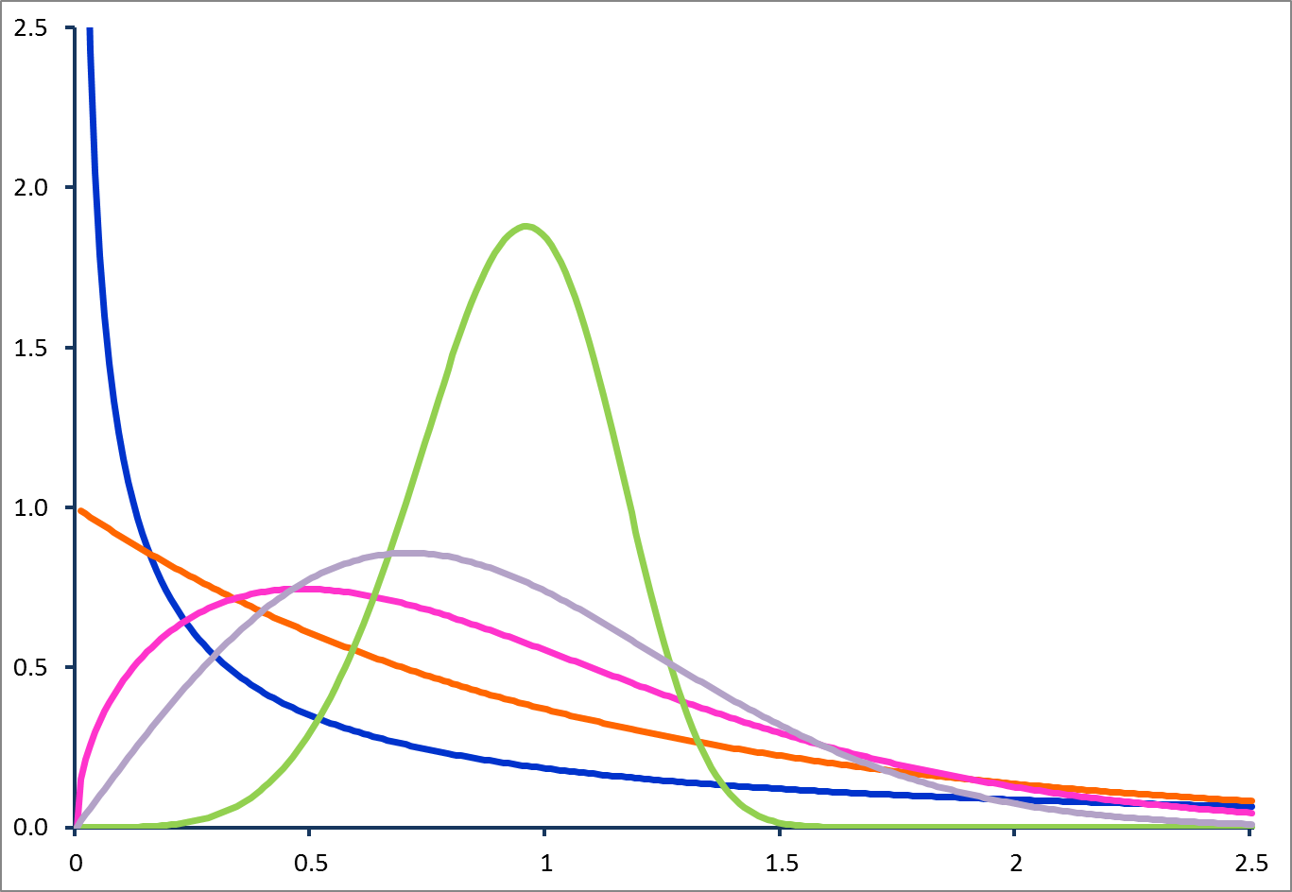
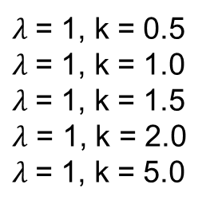
Flexibility of the Weibull Curve
$λ$= 1, k = 0.5
$λ$= 1, k = 1.0
$λ$= 1, k = 1.5
$λ$ = 1, k = 2.0
$λ$= 1, k = 5.0
At k = 2; Weibull is equal to Rayleigh

Slide 7
Overfitting
When a model is too complex for the data set
An overfitted model will poorly predict performance outside training data set
Rule of thumb: 10-15 data points per parameter
Defense R&D projects rarely have 30-45 data points available
Is a linear model (2 parameters) accurate with 3 or 4 data points?
  Weibull model (with 3 parameters) requires a lot of data (30-45)

Slide 8
Overfitting: Part 2
Slopes and Y-intercepts change while R² is similar
Estimates change greatly
10 points
20 points
  Applying rule: linear model requires 20-30 points before parameter estimates will stabilize around the population mean

Slide 9
Overfitting: Part 3
Similar Slopes and Y-intercepts
Estimates stable
20 points
30 points
  Weibull model (with 4 parameters) requires a lot of data (40-60)

Slide 10
Overfitting: Part 4
Projections very different depending on amount of data used
  Predictions stabilize once sufficient data is available

Slide 11
Overfitting: Solutions
Three ways to deal with this:
  Use Weibull degenerates (like the Rayleigh) with fewer parameters
    Reduce the amount of required data
  Estimate parameters from other features of the project (AKA, get more data)
    “Create” more data by considering other information
  Use a different method
    Find another method that isn’t as data hungry

Slide 12
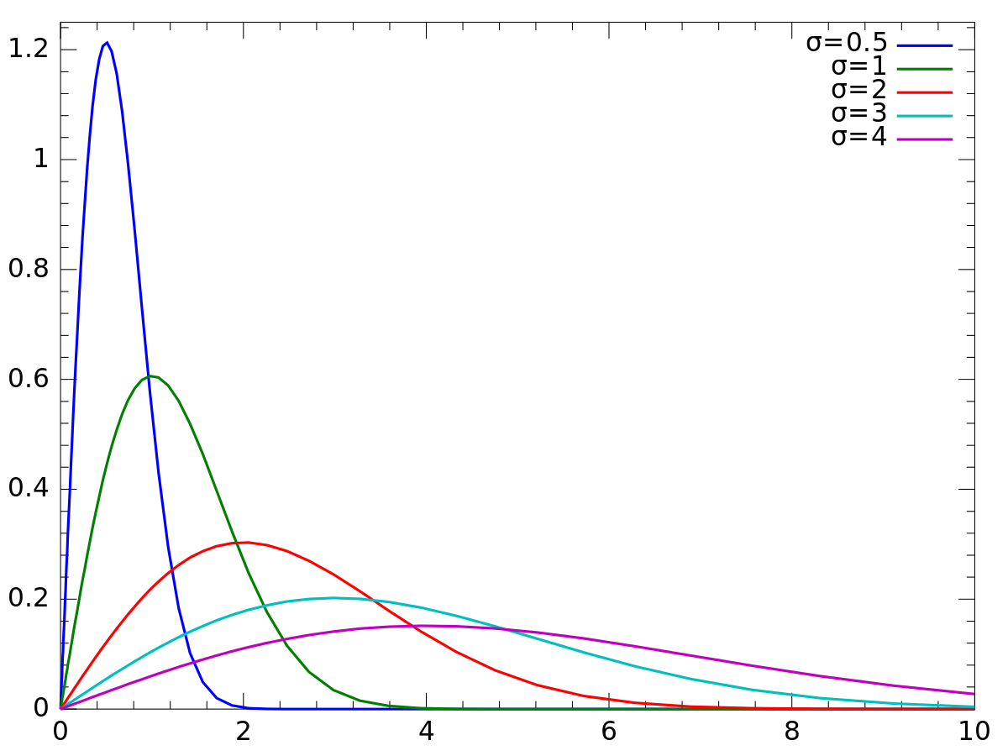
The Rayleigh Curve
Developed from Manpower Utilization model developed by P.V. Norden in the 1960s
Pattern is approximated by Rayleigh Function
If true, allows for total effort and duration to be estimated from the trajectory of early effort
  For our purposes this is conveyed by ACWP as reported in EVM CPRs
Major Simplification = Mode assumed to fall at the 39th percentile
Rayleigh is a degenerate (or restricted version) of the Weibull

Slide 13
Rayleigh Model
Cost Parameter
Rayleigh shape or “profile” is assumed – parameter fits simply scale function to data
Scale Parameter
By assuming a fixed shape parameter, we are scaling the cost and duration of the fixed Rayleigh profile to find the combination of the two that best fits our data

Slide 14
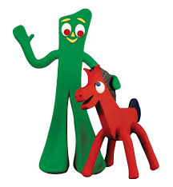
Rayleigh vs. Weibull
Demo to be done in Excel

Slide 15
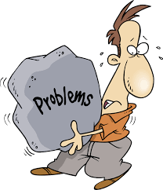
The Problem
Restricted models, like the Rayleigh, require a major assumption that projects have the Rayleigh profile
Evidence is mixed on this assumption
Rayleigh has predictive power because of the assumed profile
Weibull lacks predictive power because it can take on a variety of forms
  An effective heuristic to determine which Weibull fits the problem at hand is needed

Slide 16

Possible Solution
Rayleigh method assumes a profile
Instead of assuming a profile, why not use two-stage model to predict profile, and then predict cost and duration?
Won’t work off existing CPR data
Could work if additional independent information about the project allowed for classification
NCCA hasn’t done this yet, but other people have tried…

Slide 17
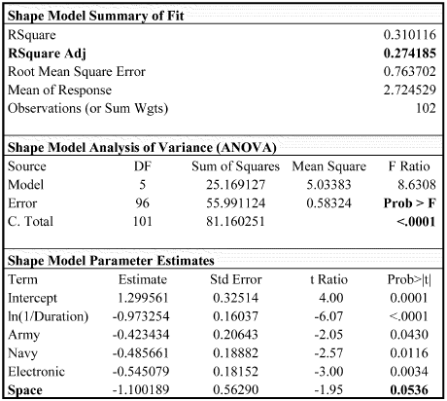
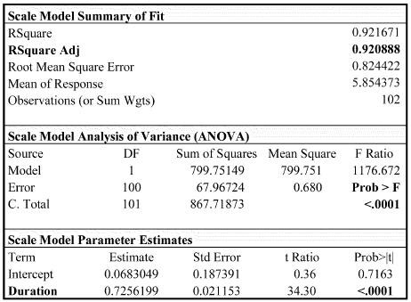
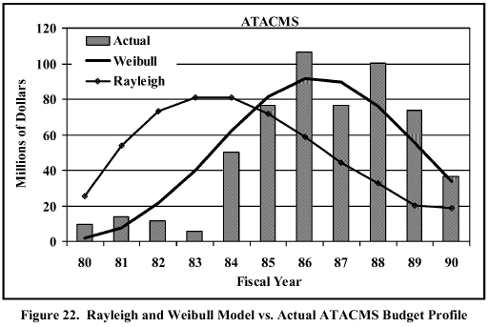
Air Force Institute of Technology (AFIT) Weibull Model
Attempted to address the overfitting problem via a two-stage model
Step 1: Develop regression using program characteristics to predict best Shape and Scale parameters
Step 2: Fit a Weibull model using estimated parameters and optimizing for budget parameter
See: “Forecasting Research and Development Program Budgets Using the Weibull Model” Captain Thomas W. Brown USAF, March 2002, Air Force Institute of Technology

Slide 18
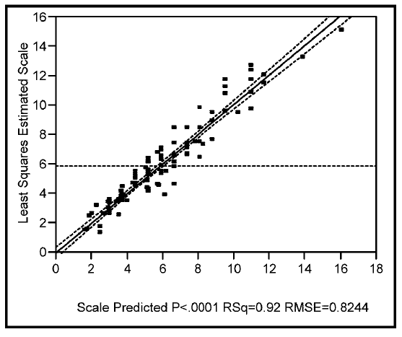
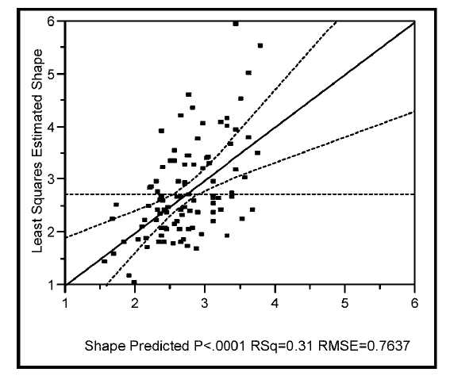
AFIT Model: Results
Predict Scale and Shape as a function of service, system type, total cost, and duration
Results: success predicting scale (and to a lesser extent Shape) – Forecasted Weibull models correlated well to project expenditures, but the associated duration and cost estimates were not evaluated for accuracy

Slide 19
NCCA Evaluation Criteria
In DoD use, phasing curves are used to make specific predictions regarding three things:
  Profile: the period by period expenditures
  Duration: The total amount of time required
  Total Cost: The total amount required to complete the project
Any proposed Phasing Model should be evaluated in all 3 dimensions before use
AFIT model appears promising, but was not fully evaluated for this use case

Slide 20
Summary
Parametric phasing models can be an effective tool for independent evaluation of R&D projects
Estimators must be careful when using complex models early in a project
  Complex models require larger amounts of data
Rayleigh model is well supported by a large body of research, but has known limitations
The more complex Weibull shows promise, but requires further research regarding the overfitting problem
Analysts must think critically regarding their use case and ensure the model selected is appropriate for the problem at hand

Slide 21

Future Study
Evaluate AFIT model in the context of the early R&D forecasting use case
Explore alternate predictors for shape, scale, and location parameters (beyond what was considered in the AFIT study)

Slide 22


Questions?

