Slide 1

SURF Process Update and 2017 Review
Presented by:
Marc Russo, NCCA
This document was generated as a result of the AFCAA-led, Software Resource Data Report Working Group (SRDRWG). This working group represented a joint effort amongst all DoD service cost agencies. The following guidance describes SRDR data verification and validation best practices as documented by NCCA, NAVAIR 4.2, AFCAA, ODASA-CE, MDA, and many more.

Slide 2
Table of Contents
  Purpose
  SURF Purpose
  SURF Team Structure
  SURF Verification & Validation (V&V) Guide
  SRDR V&V Outline
  Key Updates
  2017 Metrics
  Team Status
  SRDR Database
  SRDR Data Quality Review
  Summary

Slide 3
Presentation Purpose
  Provide an overview of the updated Software Resource Data Reporting (SRDR) Verification and Validation (V&V) guide and question templates
  To update the audience on the reviews that the SRDR Unified Review Function (SURF) team conducted in 2017
  Give the audience information on how to become active within the SURF team

Slide 4
SURF Purpose
How is this team unique and why do we need quality data?
Purpose:
To supplement the Defense Cost Resource Center (DCARC) quality review for SRDR submissions
To develop a consistent, service-wide set of quality questions for all DoD cost community members to reference
To provide a consistent, structured list of questions, focus areas, and possible solutions to cost community members tasked with inspecting SRDR data submissions for completeness, consistency, quality, and usability (e.g. SRDR V&V Guide)
Why?
SURF represents an effort to establish a consistent guide for any organization assessing the realism, quality, and usability of SRDR data submissions
Quality data underpins quality cost and schedule estimates
Question: What services helped develop the questions included within the latest SRDR V&V guide?
Answer: All services participating in the SRDR WG provided feedback, comments, and reviews over a year long SRDRWG effort focused on establishing higher quality review efforts coupled with an ongoing SRDR DID update

Slide 5

SURF Team Structure
  Team is comprised of one primary member per service along with support from secondary team members (Government Only)
  As submissions are received, SRDR review efforts will be distributed amongst SURF team members to balance workload
  SURF Team Coordinators (STC): Marc Russo & Haset Gebre-Mariam
  Current SURF structure:
DCARC Analyst & STC:
SURF Team Coordinators (STC)
Marc Russo
Haset Gebre-Mariam
SRDR Submission received from DCARC
SURF Advisor & Process Owner (SAPO)
Nick Lanham
SURF Primary:
DoD
William Raines
Navy
Corrinne Wallshein
Wilson Rosa
Marine Corps
Susan Wileman
Air Force
Ron Cipressi
Army
Jim Judy
Jenna Meyers
James Doswell
SPAWAR
Jeremiah Hayden
MDA
Dan Strickland
SURF Secondary:
Stephen Palmer
Philip Draheim
Bella Curtis
John Bryant
Shannon Moore
Bruce Thompson
Reshica Wigfall
Michael Smith
Michael Duarte
Min-Jung Gantt
Question: How do members get involved with SURF? Why are there “primary” and “secondary” members?
Answer 1: The SURF team was established by Government SRDRWG members who were recommended/volunteered by each DoD service
Answer 2: Primary members are included on CSDR S-R IPT email notifications for their specific service. Secondary members are contacted during periods of increased review demands, if necessary.

Slide 6
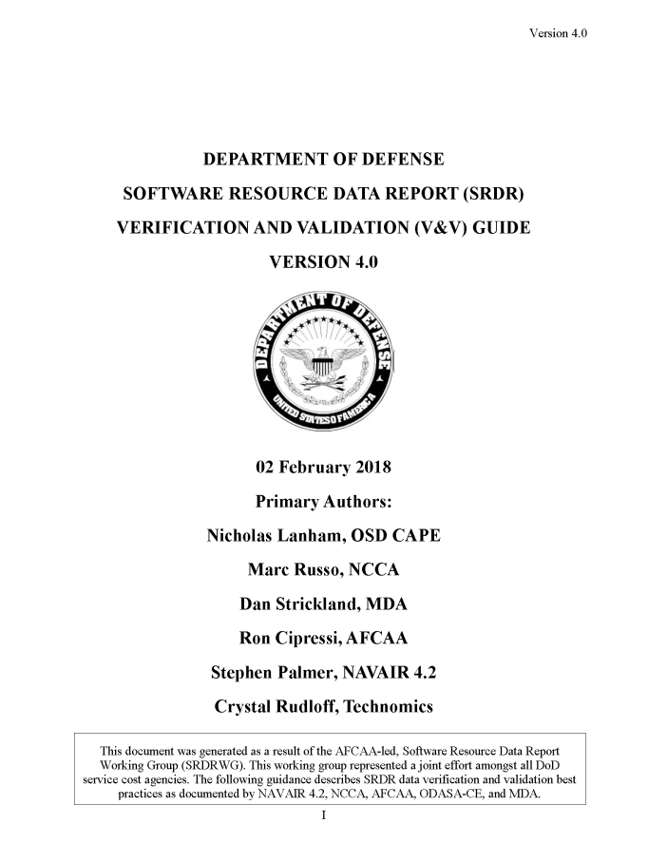
SRDR V&V Guide
Update Completed in Feb 2018
Update of V&V guide approved for public release on 20 March 2018
  Incorporates question templates into V&V guide
  Updates based on new DID, lessons learned, and feedback from DCARC and SURF team members
  Files can be downloaded using following link: http://cade.osd.mil/(S(5ivcwktd0e3brmm1srcwqs4q))/policy/srdr
Improves ability to consistently isolate software cost relationships and trends based on quality SRDR data
  Additional excel question templates map to new DIDs (Format 1, 2, 3 and Legacy)
Two main purposes:
  SRDR V&V training guide (V&V questions)
  Focus areas used to determine SRDR quality tags

Slide 7
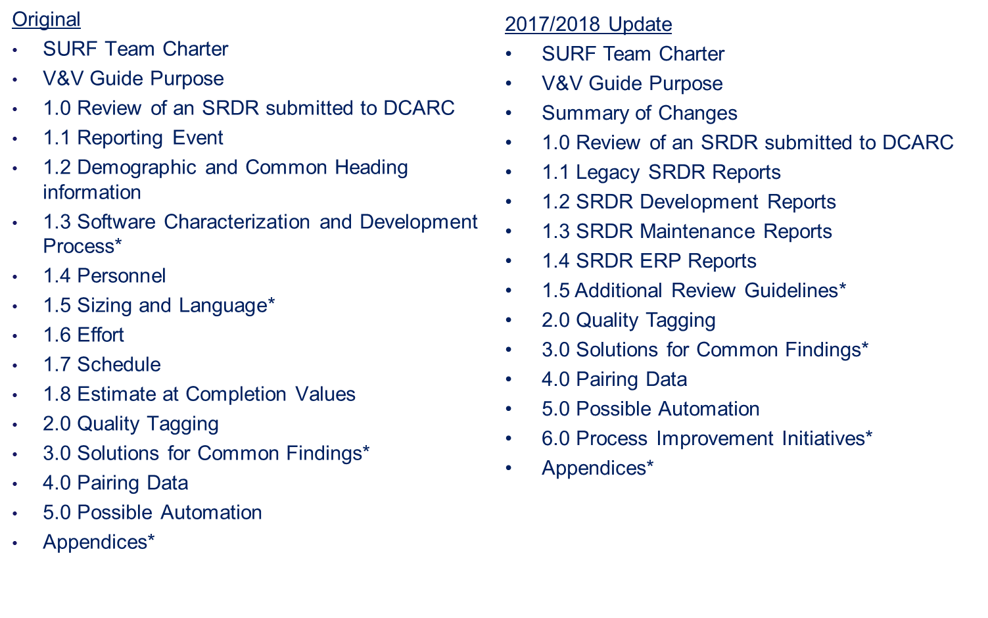
V&V Outline Update
* Parent elements for children elements not displayed here

Slide 8
Key Updates
V&V Guide
Guide rewritten to discuss use of question templates
Provides additional guidance on the importance of using comments in defining the issue for DCARC
Process Improvement/Initiative Section added
  Providing additional comments and reach back for DCARC
  Use of CADE for collecting V&V checklist data
  Establishing process review meetings between DCARC and SURF analyst
  Allows flexibility in the SURF process to accommodate updates in software acquisition management
Updates to Quality Tagging Appendix
  Updated definitions
  Added new quality tags (Good-Alteration, Good- Roll Up, and Allocation)
Notes:
Stress the continual refinement of this process. Software Acquisition Management changes and the SRDR products and reviews have to change with it.
What was once Object-Oriented development, Model-Based System Engineering, and Software Product Lines is now moving to Agile and whatever is next. The
SURF has to take a holistic approach to SRDRs and give an informed opinion of red flags or key points of interest to a CAPE analyst who may not have
the level of expertise or background that we do. It's a way for the CAPE to have a clearinghouse of SMEs to triage the SRDRs as they arrive. This is especially key as the change over to the new DID is not always smooth for
all our development contractors.

Slide 9
Key Updates
Question Templates
Additional SURF Analyst Inputs
  Supports DCARC in determining key issues
  Supports NAVAIR 4.2 team in inputting data into SRDR database with inputs for OE, AD, and SD
Additional Question Templates
  Format 1 DD Form 3026-1 (Development)
  Format 2 DD Form 3026-2 (Maintenance)
  Format 3 DD Form 3026-3 (ERP)
Improved Questions
  Questions updated so “Yes” is a positive response and “No” is a negative response
  Removed questions that had no direct reference in new DID

Slide 10
2017 Metrics

Slide 11
V&V Questions Most Frequently With “Yes” Response
All Reviews (2017)
Question ID | Questions from V&V Guide Template | Yes | No | N/A
1.2.12 | Is the contract number reported? | 35 | 1 | 0
1.2.7 | Has the contractor or organization that performed the work been identified? | 34 | 1 | 0
1.2.20 | Has the report type been identified (for example: Initial, Interim, or Final)? | 34 | 1 | 0
1.2.1 | Has the program name been identified? | 33 | 3 | 0
1.2.21 | Is there a single submission Point of Contact (POC) and supporting contact information included within the report? | 33 | 1 | 0
1.1.2 | Does the report reference the CSDR Plan? | 32 | 3 | 0
1.2.3 | Is the Prime Mission Product (PMP) name been clearly identified (for example: most current official military designation? | 31 | 3 | 1
1.7.1 | Has schedule data been included in the submission? | 31 | 2 | 0
1.1.6 | Is there an easily identifiable event associated with the submission (for example: Contract Award, Build 2 Release, Build 1 Complete, Contract Complete, etc.)? | 30 | 5 | 0
1.2.9 | Has the specific site or subdivision for the contractor been identified? | 30 | 6 | 0
1.3.3.2 | Has the contractor indicated whether the software is an upgrade or new development? If Xt, why Xt? | 30 | 2 | 1
1.7.3 | Has schedule data been reported in number of months from contract start or as calendar dates? | 30 | 2 | 1
1.2.5 | Is the system description been included within the submission? | 29 | 6 | 0
1.2.10 | Has the contractor or submitting organization illustrated whether they were the primary or secondary developer? | 29 | 5 | 2
1.5.2.1 | Was the primary programming language reported? | 29 | 1 | 2
1.2.8 | Has the reporting contractor or organization address and zip code been included? | 28 | 8 | 0
1.3.1.1 | Does the SRDR submission, comments section, or data dictionary include a clear system level functional description and software operational overview? | 28 | 6 | 0
1.7.2 | Has the submitting organization clearly stated if the provided schedule data was reported as estimated, allocated, or actual results? | 28 | 3 | 2
1.1.3 | Has the plan type been identified (for example: prime contract, subcontract, or Xt applicable)? | 27 | 8 | 0
1.3.3.1 | Has the contractor listed a standard process, or is there a unique identifier in the SRDR data dictionary describing what the process is? | 27 | 5 | 1
1.2.19 | Has the contract Period of Performance (PoP) been identified? | 26 | 9 | 0
1.3.1.4 | Does each CSCI or WBS element include a naming convention specific to the intended software function? | 26 | 6 | 2
1.3.3.5 | Has the development method also been identified (for example: Structured Analysis, Object Oriented, Vienna Development, etc.)? | 26 | 3 | 3
1.4.6 | Has the contractor identified the standard hours in an accounting month when determining the peak FTE? | 26 | 6 | 1
1.6.4 | Is effort data broken out by activity? | 26 | 2 | 2
1.7.4 | Is schedule data broken out by SRDR activity? | 26 | 2 | 4
1.2.4 | Has the Defense material item category been provided in accordance with MIL-STD-881C guidance (for example: Aircraft, radar, ship, Unmanned Ariel Vehicle (UAV) system)? | 25 | 9 | 1
1.5.1.5 | Does the data dictionary provide a description of how a requirement is counted (e.g. discrete shall statements, functions derived from shall statements, etc.) and what constitutes a new requirement versus existing? | 25 | 5 | 1
1.6.3 | Is the effort data reported in hours? | 25 | 6 | 2
1.2.14 | Is the software process maturity and quality reporting definition provided (For example: Capability Maturity Model (CMM), Capability Maturity Model Integration (CMMI), or other alternative rating)? | 24 | 10 | 1
Most questions with frequent “yes” response are meta data questions that will be covered under the “common heading” section of new SRDRs

Slide 12
V&V Questions Most Frequently With “No” Response
All Reviews (2017)
Question ID | Questions from V&V Guide Template | Yes | No | N/A
1.2.18 | Has the total contract price been identified? | 0 | 33 | 2
1.5.1.2 | Has the submitting organization separated the provided requirements by Security, Safety, and Privacy or Cybersecurity? | 4 | 26 | 2
1.2.2 | Has the Major Defense Acquisition Program (MDAP) or Major Automated Information System (MAIS) designation been listed? | 11 | 21 | 3
1.5.4.2 | Has the priority level for each category of software defects been provided? | 0 | 19 | 14
1.5.4.1 | Has the submitting organization provided a breakout of the number of software defects Discovered, Removed, and Deferred? | 3 | 18 | 12
1.6.7 | Is there an explanation of missing activities included within the supporting SRDR data dictionary? | 6 | 17 | 10
1.3.1.2 | Does the SRDR submission include a detailed functional description for each CSCI? (Xte: it is Xt uncommon for submissions to include the same, abbreviated functional description for every CSCI rather than a detailed functional description specific to each CSCI included within the SRDR submission. If this scenario occurs, we recommend contacting the submitting organization for additional detail). | 18 | 16 | 0
1.3.1.3 | If a detailed CSCI-level functional description is Xt included within the SRDR submission, is it included within the supporting SRDR data dictionary or comment section? | 9 | 15 | 10
1.3.2.3 | Has the state of development been identified (For example: Prototype, Production Ready, or a mix of the two)? | 17 | 15 | 1
1.3.2.1 | Does the SRDR data dictionary include a clear system-level functional description and software operational overview? | 17 | 14 | 2
1.5.1.1 | Does the submission clearly illustrate the number of Inherited, Added, Modified, Deleted, and Deferred requirements for both internal and external categories? | 14 | 14 | 4
1.5.2.16 | If COTS or GOTS items have been included within the submission, has the submitting organization provided the SLOC total required to integrate the identified COTS/GOTS product (i.e. Glue code)? | 2 | 14 | 16
1.6.8 | Was the effort data for each activity based on a proration scheme, i.e. percentage based? The analyst will typically have to calculate and confirm if the same percentages show up across multiple CSCIs or WBS elements. | 8 | 14 | 11
1.8.1 | EACH: Has a description been provided that describes which ISO 12207:2008 elements have been included within the provided total? | 1 | 14 | 18
1.2.16 | Is the specific U.S Military service branch or customer identified (For example: Navy, Air Force, Army, prime contractor, etc.)? | 22 | 13 | 0
1.5.4.3 | If the report is an interim or final submission, has the number of Discovered, Removed, and Deferred defects changed from the previous submission? If significant changes have occurred, does the supporting comments section and/or data dictionary provide details regarding what drove the significant change in product quality metrics? | 2 | 12 | 19
1.6.6 | Were common WBS elements/labor categories such as System Engineering (SE), Program Management (PM), Configuration Management (CM), or Quality Management (QM) been broken out separately? | 20 | 12 | 1
1.2.6 | Have the program phase and/or milestone been included within the report (for example: Pre-A, A, B, C-LRIP, C-FRP, O&S, etc.)? | 22 | 11 | 2
1.2.15 | Is the Process Maturity rating reported with an associated date, and has it changed from a prior submission? | 19 | 11 | 5
1.3.2.2 | If a system-level functional description has been included, does it include details regarding manned or unmanned system configurations? | 12 | 11 | 10
1.5.1.6 | If external interface requirements are identified, does the dictionary describe what these are and how they were determined? | 15 | 11 | 6
1.5.2.4 | Did the submitter us the Aerospace-approved version of the University of Southern California (USC) Center for Systems and Software Engineering (CSSE) Unified Code Count (UCC) tool to count the provided SLOC totals? If Xt, was the name of the code counting tool used by the submitting organization included within the supporting comments section and/or data dictionary? | 12 | 11 | 7
1.6.15 | Do all CSCI or WBS elements include effort values that are inclusive of common "overhead" or "indirect" labor categories within the provided effort total? For example, are there separate CSCI or WBS elements that reflect "effort-only" data within a separately reported CSCI or WBS element? (i.e. has quality assurance or configuration management effort been reported as separate WBS/CSCI elements)? If so, can that effort be reasonably allocated back to the primary WBS/CSCI? | 11 | 11 | 10
1.2.14 | Is the software process maturity and quality reporting definition provided (For example: Capability Maturity Model (CMM), Capability Maturity Model Integration (CMMI), or other alternative rating)? | 24 | 10 | 1
Several questions with frequent “no” response are improved/removed with new question templates
Data important to understanding the software and how to best use for cost analysis are often missing

Slide 13
V&V Questions Most Frequently With “N/A” Response
All Reviews (2017)
Question ID | Questions from V&V Guide Template | Yes | No | N/A
1.5.3.2 | If function points have been provided has the submitting organization clearly illustrated the function point count type (For example: Enhancement Project, Application, or Development Project)? | 2 | 1 | 30
1.5.3.5 | If the submitting organization has provided sizing metrics using the Reports, Interfaces, Conversions, Extensions, Forms, and Workflows (RICE-FW) convention, has the complexity of each RICE-FW category been provided? | 3 | 1 | 29
1.6.17 | If subcontractor hours have Xt been provided, did the reporting organization provide subcontractor dollars? | 0 | 4 | 29
1.7.7 | If the submission is a final report or includes a prior build, does the provided schedule data align with the prior report? If Xt, is there an explanation for significant changes in the schedule? | 4 | 1 | 28
1.5.2.11 | Were SLOC counts reported in aXther data submission and are they traceable from submission to submission or build to build, if applicable? | 2 | 2 | 27
1.5.2.17 | If COTS or GOTS integration or glue code has been included within the submission, does the total seem realistic when compared to the total SLOC included in the CSCI or WBS element (For example: COTS integration code equals 500 KSLOC and the total SLOC for the specific CSCI or WBS element equals 150 KSLOC)? Xte: this scenario sometime occurs when the submitting organization counts the total SLOC of the specified COTS or GOTS product vice the integration or glue code required to integrate the product. | 1 | 4 | 27
1.5.3.3 | Has the submitting organization provided the number of Data Functions and Transactional Functions (For example: Internal Logic Files, External Interface File, External Inquiries, External Inputs, and External Outputs)? | 3 | 3 | 27
1.1.10 | If this is a Final Report, was there an Initial Report it can be traced to? | 4 | 5 | 26
1.2.11 | If effort was outsourced, has the outsourced organization been provided? | 3 | 6 | 26
1.5.2.9 | For a Final report does the size look realistic? For example: is all of the code rounded to the nearest 1000 lines, or does the dictionary indicate that they had difficulty counting code that may have come from a subcontractor? | 6 | 0 | 26
1.5.2.14 | When subcontractor code is present, is it segregated from the prime contractor effort, and does it meet the same criteria for quality as the prime’s code count? | 6 | 0 | 26
1.4.2 | If there was a prior submission, has the skill mix changed dramatically and, if so, is there an explanation why? Conversely, did it remain unchanged? If so, why? | 3 | 6 | 24
1.5.3.4 | Has the submitting organization included the Value Adjustment Factor? | 3 | 6 | 24
1.8.2 | EACH: Do sub-element EAC values sum to the parent EAC total value? | 2 | 8 | 23
1.1.8 | If a prior submissions exists, is the information that has changed readily identifiable and a reason for the change provided (either in the data dictionary or comments section)? | 9 | 4 | 22
1.6.13 | Has the subcontractor's effort been reported separately? For example, has the subcontractor data been mixed within the prime contractor's values, is the data missing, or has the data been reported separately? | 8 | 3 | 22
1.1.5 | Is there consistency of Xmenclature and WBS numbering from submission to submission? | 13 | 2 | 20
1.1.7 | If there are prior submissions, is this submission an update to a prior submission or a new event? If the submission is an update to an existing submission, does the latest submission clearly describe what report the prior submission is linked to? | 9 | 7 | 19
1.5.2.8 | Do multiple records have the same SLOC sizing data (i.e. size data is repeated for each code type or total size is repeated)? Should they be repeated because they are roll ups of WBS/CSCI elements or has a proration scheme been used to estimate sizing values? | 6 | 7 | 19
1.5.2.10 | Were code adaptation factors reported (percent redesign, recode, reintegration)? Do they appear to be unique for each CSCI, or are they standard rules of thumb? | 3 | 10 | 19
1.5.4.3 | If the report is an interim or final submission, has the number of Discovered, Removed, and Deferred defects changed from the previous submission? If significant changes have occurred, does the supporting comments section and/or data dictionary provide details regarding what drove the significant change in product quality metrics? | 2 | 12 | 19
1.8.1 | EACH: Has a description been provided that describes which ISO 12207:2008 elements have been included within the provided total? | 1 | 14 | 18
Several questions with frequent “N/A” responses come from uncommon occurrences

Slide 14
SURF Team Status
2017 Overview
  SURF team highlights
    Group includes ~19 Government team members from across the DoD
    Has received very positive feed back from DoD cost estimation community, DCARC analyst(s), and even program office communities since inception
    Completed update of SRDR V&V guide March 2018
    During 2017 SURF team generated 1,879 V&V comments provided to DCARC
    In total the SURF team generated 3,251 V&V comments from 128 SRDR submissions
  DCARC SRDR Submissions
    62 New SRDRs (does not include resubmits)
    30 Air Force, 11 Army, 2 DoD, 19 Navy
    29 Accepted, 21 Rejected, 12 Under Review/Being Corrected by Contractor
  V&V Comments Have Significantly Improved SRDR Data Quality

Slide 15
SRDR Data Quality Review
Dataset Posted to OSD CAPE DACIMS Web Portal
Data Segments | Dec-07 | Dec-08 | Oct-10 | Oct -11 | Aug-13 | Apr-14 | Apr-15 | Dec-16 | Jun-17 | Oct-17
CSCI Records | 688 | 964 | 1473 | 1890 | 2546 | 2624 | 2853 | 3487 | 3583 | 3747
Completed program or build | 88 | 191 | 412 | 545 | 790 | 911 | 1074 | 1326 | 1391 | 1604
Actuals considered for analysis (e.g., “Good”) | 0 | 119 | 206 | 279 | 400 | 403 | 682 | 829 | 974 | 992
Paired Initial and Final Records | 0 | 0 | 78 | 142 | 212 | 212 | 212 | 240 | 271 | 274
  SRDR database is available to Government analysts with access to the CADE portal
  This dataset is the authoritative source for SRDR data (10+ years of uploads)
  Data is not automatically considered “Good” for analysis
  SURF team may recommend DCARC not accept a submission due several data quality concerns outlined in the V&V guide. Examples include:
  Roll-up of lower level data (Did not want to double count effect)
  Significant missing content in hours, productivity, and/or SLOC data missing
  Interim build actual that is not stand alone
  Inconsistencies or oddities in the submit
  Additional reasons discussed in the V&V guide

Slide 16
SRDR Data Quality Review
2014-2018 Trend Analysis
SURF Initiation
  Total records does not include ~1400 “bad” records that were collected prior to April 2014
  Prior to SURF process, only 35% of SRDR data was considered “Good”
  Currently, ~43% of the data had been tagged as “Good”
  SRDR database available to government employees within the DACIMS library (http://cade.osd.mil/)
  SURF Team Combined With V&V Guide and DCARC
  Have Significantly Improved Software Data Quality
Notes:
"What Life Was Like Before SURF“: It was Dodge City, with only Nick and Mike Popp at NAVAIR
doing any quality control management. SRDRs came in and were widely accepted
as fact in DACIMS as long as there was a 881-C compliant CSDR plan submitted
with it. CAPE was hamstrung with software data not being addressed by
software personnel. This is systemic across all of DoD and addressed by the
new SW Estimation DAU course, SRDR WG, and of course the SURF. Places
software savvy costers in the development loop to untangle the language
usually reserved for SW Engineers.

Slide 17
How to get involved!
Government employees
  Volunteer to be a SURF member
  Use and review SRDR database
Contractors/Industry
  Be aware of SRDR V&V guide
  When developing/reviewing SRDRs use V&V guide and question templates to ensure everything is captured
Provide comments and suggestions for updating review process

Slide 18
SURF Summary
SURF is focused on improving data quality and helping support robust Government review process
We would like to thank all of the DoD and Non-DoD individuals who have commented, participated, and provided feedback throughout the past few years
Please feel free to use the contact information below if you would like more information regarding SURF, the SRDR V&V Guide, or checklist
  Marc Russo
  Naval Center for Cost Analysis (NCCA)
  NIPR: Marc.russo1@navy.mil
  Ron Cipressi
  Air Force Cost Analysis Agency
  NIPR: Ronald.p.cipressi.civ@mail.mil
  Nicholas Lanham
  Office of Secretary of Defense
  Cost Assessment and Program Evaluations
  NIPR: Nicholas.a.lanham.civ@mail.mil
  Dan Strickland
  Missile Defense Agency (MDA)
  NIPR: Daniel.strickland@mda.mil

Slide 19
BACK-UP

Slide 20
How Was SURF Created?
Cost Leadership Forum (CLF) Approved SRDR Initiatives
(Dec 2014)
Recommendation
Benefit
Revised SRDR Development Data Item Description (DID)
New SRDR Maintenance Data Item Description (DID)
Joint Validation & Verification (V&V) Guide, Team, and Process
Software Database Initial Design and Implementation Process
Reduces inconsistency, lack of visibility, complexity, and subjectivity in reporting
Aligned w/ dev. but w/ unique data/metrics available/desired for maintenance phase
Higher quality, less duplication - ONE central vs many distributed; 1 joint team & guide gives early, consistent feedback to ktrs
Avoids duplication, variations - ONE central vs many distributed; Based on surveyed best practices and user expectations
Question: How was the SURF team created and is it linked to the SRDRWG?
Answer: Yes. The SRDR Unified Review Function (SURF) team was organized as part of the larger, SRDRWG initiative during 2015

Slide 21
SURF Need Statement
Why do these reports need to be reviewed?
Reduces inaccurate use of historical software data
  Aligns with OSD CAPE initiative(s) to improve data quality
Helps correct quality concerns prior to final SRDR acceptance
Allows a central group of software V&V SMEs to tag SRDR data
SRDR submissions are used by all DoD cost agencies when developing or assessing cost estimates
Quality data underpins quality cost and schedule estimates
  BBP Principle 2: Data should drive policy. Outside my door a sign is posted that reads, "In God We Trust; All Others Must Bring Data." The quote is attributed to W. Edwards Deming
  - Mr. Frank Kendall, AT&L Magazine Article, January-February 2016

Slide 22

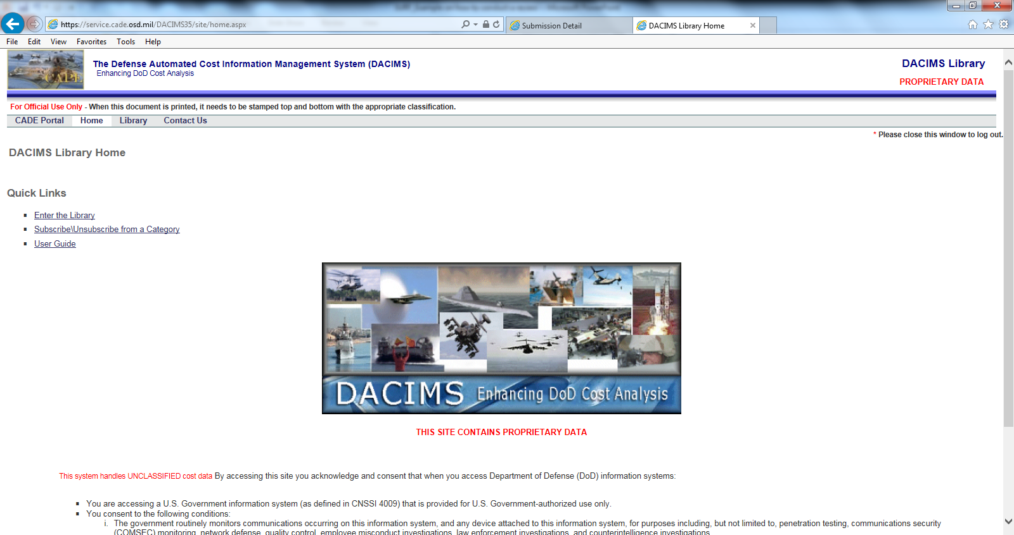
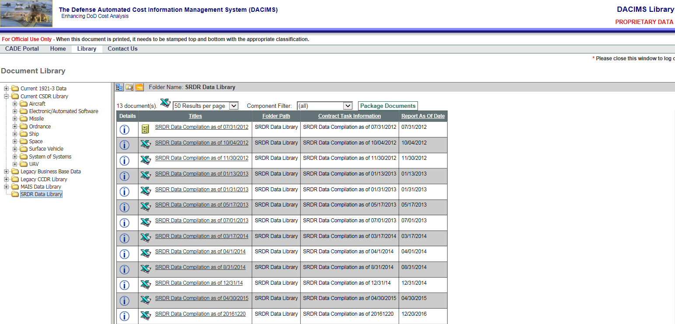
SRDR Database Location
Where Does SRDR Go After SURF Review?
  Login to CADE
    http://cade.osd.mil/
  Navigate to DACIMs
  Select “SRDR Data Library” from folder tree on left side of screen
  Filter by “Report As Of Date” to download latest version of dataset
  Database to be updated in CADE by end of June 2017
    Quarterly updates to database after June release
Question: Where does SRDR data go after SURF Review?
Answer: Once SRDR record has been accepted, Data is entered into SRDR dataset posted to CADE>DACIMs web portal
Question: Who enters the data into the dataset?
Answer: Currently members from NAVAIR 4.2 enter data to SRDR dataset (10+ years of experience). Future data entry is planned to be automated using .XML schemas linked to latest DID formats

Slide 23



SURF Team V&V Process
Monthly Recurring SURF and DCARC Communications
DCARC: Step 1
SURF: Step 1
SRDR status list sent to SURF Team Coordinator
SRDR status list distributed to Primary and Secondary POCs
SURF: Step 2
Conduct V&V reviews by populating MS Excel question template
SURF: Step 3
Provide completed V&V question templates back to DCARC
DCARC: Step 2
Combine SURF and DCARC comments
Coordinate comment resolution with submitting organization
Database: Step 1
Adjudicated SRDR sent to NAVAIR 4.2 for data entry into DACIMs dataset
Note: Future database(s) will be hosted via CADE
1st week of every month
+2 Days
+ 13 Days
NLT
+ 14 Days
Varies by Contractor
Varies by No. Submissions
Purpose of SURF Process: To provide completed V&V checklists to DCARC within 2 weeks of request
Important Note: CADE is developing relational databases for new DID formats. Over time, data entry will be automated. Until that time, manual data entry continues by NAVAIR 4.2 team for only the development format. Please refer to V&V guide for additional automation details and future data quality initiatives

