Slide 1
Through the Eyes of an Auditor
Overview of GAO Best Practice Guides and Audit Results
January 22, 2018

Slide 2
OUTLINE
Overview of GAO
GAO’s Best Practices Guides
Audit Results

Slide 3
The Role of GAO in Government
Known as the investigative arm of Congress, GAO exists to support Congress in meeting its constitutional responsibilities.
To that end, GAO works to
  Help improve the performance of federal government
  Ensure government agencies and programs are accountable to the American people
  Examine the use of public funds, and
  Evaluate federal programs by providing analyses and recommendations to help Congress make informed oversight and funding decisions

Slide 4
Importance of Best Practice Guides
Legislators, government officials, and the public want to know
  Whether government programs are achieving their goals
  What these programs are expected to cost and when they will be finished
Developing reliable program cost and schedule estimates are critical to
  Effectively using public funds
  Meeting OMB’s capital programming process
  Avoiding cost overruns, missed deadlines, and performance shortfalls

Slide 5
GAO Best Practice Guides
Purpose of the Guides are to
  Address best practices for ensuring credible program cost and schedule estimates for both government and industry
  Provide a detailed link between cost estimating, scheduling, and EVM
    OMB has endorsed EVM for measuring cost, schedule, and technical performance
    Guide demonstrates how realistic cost and schedule estimates are necessary for setting achievable program baselines and managing risk
We developed the GAO best practice guides to
  Establish consistent best practices that can be used across the federal government
  Provide auditors with a standardized approach for analyzing program costs, earned value management (EVM) data, and schedules

Slide 6
Development of Best Practice Guides
GAO seeks input from a wide range of experts, starting with planning and design through report development.
Guides are developed through an iterative, consultative process which involves a committee of experts in the related domain(s).
  Members are from government agencies, private companies, independent consultant groups, trade industry groups, and academia.
Expert meetings are open to anyone with the requisite experience and interest in the topic.
  Meeting minutes are extensively documented and archived after review by the GAO team and all participants.

Slide 7
GAO’s Published Best Practices Guides
GAO Cost Estimating and Assessment Guide:
  http://www.gao.gov/products/GAO-09-3SP
GAO Schedule Assessment Guide:
  http://www.gao.gov/products/GAO-12-120G
GAO Technical Readiness Assessment Guide:
  http://www.gao.gov/products/GAO-16-410G

Slide 8
Cost Guide Update Schedule
GAO Cost Guide is now almost 9 years old (final version published in March 2009) and is in the process of being updated
    March 2016 : Formal announcement to experts that the update was underway
    June–July 2016: Collected comments on current guide
    August 2016: Started incorporating comments and updating draft guide
    November 2018: Publish updated cost guide

Slide 9
Cost Guide Updates
Improved definitions of criteria and leading practices based on
  Lessons learned over 8 years of application
  Latest industry and government practices
Updated references to existing laws and federal guidance
Updated integration with Schedule Guide, Tech Readiness Guide, Software Agile Guide, and Standards for Internal Control
Modernized graphics and new case studies

Slide 10
2009 Cost Guide’s Layout
The Guide consists of 20 chapters with supporting appendices
  Chapters 1-17 address the importance of developing credible cost estimates and discuss in detail a 12 step cost estimating process for developing high quality cost estimates
  Chapters 18-20 address managing program costs once a contract has been awarded and discuss
    EVM
    Risk management
    Other program management best practices
The Guide also provides case studies of prior GAO audits to showcase typical pitfalls that can occur in the cost estimating process

Slide 11
The Updated Cost Guide’s Layout
The updated Guide will consists of 22 chapters with supporting appendices
  Organized by these sections
    Section 1: Introduction
    Section 2: Overview
    Section 3: 12 Steps for Creating a Cost Estimate
    Section 4: Best Practices Criteria for Evaluating a Cost Estimate
    Section 5: EVM
The Guide will also reflect new case studies of prior GAO audits to showcase typical pitfalls that can occur in the cost estimating process

Slide 12
The Updated Cost Guide’s Layout
  Chapters 1-3 provide an overview of cost estimating and explains how the 12 steps relate to the best practice criteria.
  Chapters 4-15 describe in detail a 12 step cost estimating process for developing high quality cost estimates.
  Chapters 16-19 address the importance of developing credible cost estimates and discuss the 4 best practice criteria.
  Chapters 20-22 address managing program costs once a contract has been awarded and discuss EVM

Slide 13
Characteristics of Reliable Cost Estimates
Are all costs included?
Can the estimate be recreated?
Is the estimate unbiased?
What is the uncertainty?
Comprehensive
Develop the estimating plan
Determine the estimating approach
Accurate
Develop the point estimate using appropriate estimating techniques
Rely on historical data
Update the estimate with actual costs
Credible
Conduct sensitivity analysis
Conduct risk and uncertainty analysis
Well Documented
Define the program
Identify ground rules and assumptions
Obtain data
Document the estimate
Present estimate to management
Estimate most likely costs
Perform cross checks on cost drivers
Create an independent cost estimate

Slide 14
EVM is an Important Management Tool
EVM indicates how past performance may affect future performance
  The data isolates cost and schedule variances by WBS elements allowing for:
    An understanding of technical problems
    Opportunities to reallocate effort to mitigate risk
The two main purposes for implementing an EVM system are to:
  Encourage the use of effective internal cost and schedule management controls
  Allow the customer to rely on timely and accurate data for determining contract performance

Slide 15
The Thirteen Steps in the EVM Process
Define the scope of work using a WBS
Identify who in the organization will perform the work
Schedule the work
Estimate the labor and material required and authorize budgets including MR
Determine objective measure of earned value
Develop the performance measurement baseline
Execute the work plan and record all costs
Analyze EVM performance data and record variances from PMB plan
Forecast EACs using EVM
Conduct an integrated cost-schedule risk analysis
Compare EACs from EVM in Step 9 with EAC from risk analysis in Step 10
Take management action to mitigate risks
Update the PMB as changes occur

Slide 16
Characteristics of Reliable EVM System
Is the EVM system certified and comprehensive?
Is the EVM data reliable?
Is Management using the EVM data?
Comprehensive
Certified EVM system
IBR conducted
Accurate
No data anomalies
Consistent data
Informative
Regular reviews conducted
Reliable schedule
EVM surveillance
Realistic EAC
Corrective action plans
Updated PMB

Slide 17
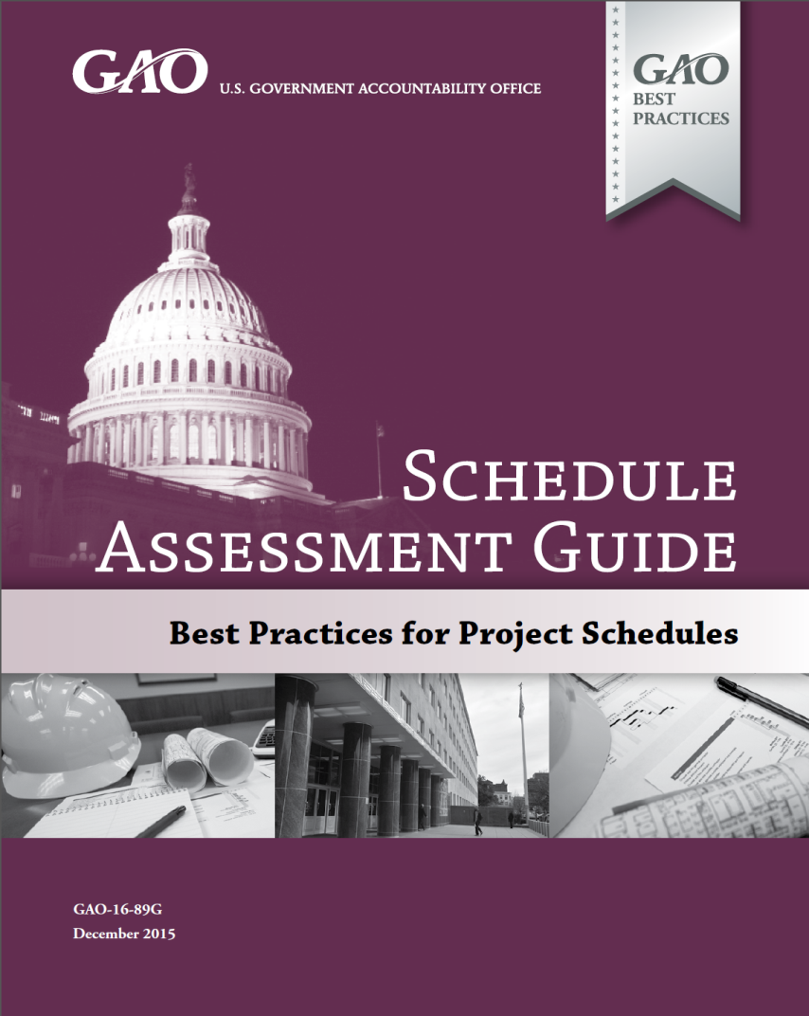
GAO’s Schedule Assessment Guide
The GAO Schedule Assessment Guide develops the scheduling concepts introduced in the GAO Cost Estimating and Assessment Guide.
  Best practices for developing and maintaining high-quality schedules
  Contains explanatory text, illustrations, and detailed case studies
  Includes appendixes that list key questions, documentation, and technical guidance
Public exposure draft released 2012-2013 and over 1,000 comments received
The Final version of the GAO Schedule Guide can be downloaded for free at
www.gao.gov/products/GAO-16-89G
Notes:
Collection of best practices and criteria to determine the extent agency programs and projects meet industry scheduling standards.
Expand on the scheduling concepts introduced in the Cost Estimating and Assessment Guide by providing ten best practices to help managers and auditors ensure that the program schedule is reliable.
The reli­ability of the schedule determines the credibility of the program’s forecasted dates for decision making.
Original schedule best practices were listed as part of the EVM section of the Cost Guide, as well as appendix X which discusses schedule risk analysis
The cost guide gives a fairly brief overview of schedule best practices but a limited description of the criteria on how to evaluate the reliability of schedules
To develop criteria for scheduling standards, we expanded on the criteria originally published in GAO’s Cost Estimating and Assessment Guide.
We developed each best practice in consultation with a committee of cost estimating, scheduling, and earned value analysis specialists from across govern­ment, private industry, and academia.
We released a public exposure draft of the GAO Schedule Assessment Guide in May 2012 and sought input and feedback from all who ex­pressed interest for two years.
We also compared the standards detailed in the guide with schedule standards and best practices developed by other agencies and organizations.
Importance of data reliability—instead of simply publishing dates that program offices report, we have the ability to confirm that the dates are reasonable through a reliability assessment of the master schedule.

Slide 18
GAO Schedule Guide
Origin
  Expands on the scheduling concepts introduced in the Cost Guide
  Intended to be an appendix to an updated version of the Cost Guide, but became its own publication
Purpose
  Allow GAO auditors to assess the reliability of reported program dates through an assessment of project schedules
  Useful for agencies to create or append existing policies and guidance on creating and maintaining project schedules
Notes:
Why are schedules important?
The success of a program depends in part on having an integrated and reliable master schedule
A schedule defines when and how long work will occur and how each activity is relat­ed to the others.
A schedule is necessary for government acquisition programs for many reasons.
The program schedule provides a road map for project execution
A schedule provides a time sequence for the duration of a program’s activities and helps everyone understand both the dates for major milestones and the activities that drive the schedule.
A program schedule is also a vehicle for developing a time-phased budget baseline.
It provides the means by which to gauge progress,
It provides the means to identify and resolve potential problems
And it promotes accountability at all levels of the program.
The schedule is a basis for managing tradeoffs between cost, sched­ule, and scope.
A schedule allows program management to
decide between possible sequences of activities
Determine the flexibility of the schedule accord­ing to available resources,
Predict the consequences of managerial action or inaction in events
Allocate contingency plans to mitigate risk.
Following changes in a program, the schedule is used to forecast the effects of delayed, deleted, and added effort, as well as possible avenues for time and cost recovery. In this respect, schedules can be used to verify and validate proposed adjustments to the planned time to complete.

Slide 19
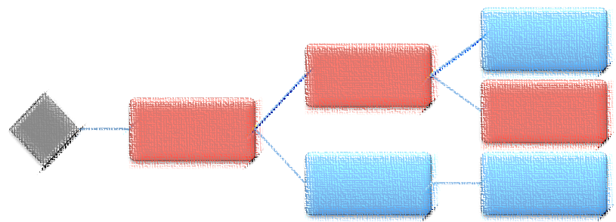
The Importance of Scheduling
The success of a program depends in part on having an integrated and reliable master schedule
A schedule is the roadmap for project execution by:
  Defining when and how long work will occur and how each activity is related to the others
  Determining a time sequence for the duration of a program’s activities
  Providing the means by which to gauge progress
Notes:
Why are schedules important?
The success of a program depends in part on having an integrated and reliable master schedule
A schedule defines when and how long work will occur and how each activity is relat­ed to the others.
A schedule is necessary for government acquisition programs for many reasons.
The program schedule provides a road map for project execution
A schedule provides a time sequence for the duration of a program’s activities and helps everyone understand both the dates for major milestones and the activities that drive the schedule.
A program schedule is also a vehicle for developing a time-phased budget baseline.
It provides the means by which to gauge progress,
It provides the means to identify and resolve potential problems
And it promotes accountability at all levels of the program.
The schedule is a basis for managing tradeoffs between cost, sched­ule, and scope.
A schedule allows program management to
decide between possible sequences of activities
Determine the flexibility of the schedule accord­ing to available resources,
Predict the consequences of managerial action or inaction in events
Allocate contingency plans to mitigate risk.
Following changes in a program, the schedule is used to forecast the effects of delayed, deleted, and added effort, as well as possible avenues for time and cost recovery. In this respect, schedules can be used to verify and validate proposed adjustments to the planned time to complete.

Slide 20
Scheduling Best Practices
Our research has identified ten best practices associated with developing and maintaining a reliable schedule
Capturing all activities
Sequencing all activities
Assigning resources to all activities
Establishing the duration of all activities
Verifying that the schedule can be traced horizontally and vertically
Confirming that the critical path is valid
Ensuring reasonable total float
Conducting a schedule risk analysis
Updating the schedule using actual progress and logic
Maintaining a Baseline Schedule

Slide 21
Characteristics of a Reliable Schedule
Is all effort included?
Is the network logical?
What is the uncertainty?
Is progress measured?
Update the schedule with progress
Maintain a schedule baseline
Comprehensive
Capture all activities
Controlled
Assign resources to all activities
Well Constructed
Sequence all activities
Confirm the critical path
Confirm reasonable float (slack)
Credible
Confirm vertical and horizontal traceability
Establish durations for all activities
Conduct a schedule risk analysis

Slide 22
Technology Readiness Assessment Guide
Drafted from 2015-2016 with the release of public exposure draft in June 2016
Outlines GAO’s criteria for evaluating technological readiness assessments
Contains 10 chapters with supporting appendixes
  Chapters 1 & 2 define TRAs and describe their importance and limitations
  Chapter 3 outlines a reliable process for conducting TRAs
  Chapters 4-10 address the associated best practices
Provides case studies of prior GAO audits to show typical findings related to technology readiness

Slide 23
Technology Readiness Assessment Guide
Fills criteria void for “performance” in the “cost-schedule-performance” trio of management elements of capital acquisition programs.
Designed to bring understanding and practice of technology readiness assessments
  Invented decades ago by NASA
  Utilized extensively in DOD, and
  Available to other agencies without a large technical staff.
Allows GAO auditors to assess the reliability of the identification and management of technologies critical to the success of a given capital acquisition program.
Useful for agencies to create or append existing policies and guidance on creating and maintaining technology readiness assessments
  Can be applied to ongoing, day-to-day project management or to support major milestone decision points.

Slide 24
Six Steps to Develop a High Quality TRA
Define Purpose
Determine purpose, level of detail, scope, TRL definition
Obtain pertinent information
Develop Strategy, Plan, and Assemble Team
Develop schedule and events
Determine specific team members and needed expertise
Select Critical Technologies
ID purpose, system, and performance characteristics in a technology baseline document
Use a Work Breakdown Structure that characterizes the system to select critical technologies
Align assessment strategy to SE management plan
Outline the approach
Identify a plan for handling dissenting views
Use key questions and environment to determine if a technology is critical

Slide 25
Six Steps to Develop a High Quality TRA
Evaluate Critical Technologies
Determine TRL definitions and required evidence prior to assessment
Prepare and Submit the TRA Report
Prepare an official report that documents actions from previous steps
Use TRA Results and Develop a Technology Maturation Plan
Use TRA results to make decisions about the program’s development priorities
Obtain report comments and explain dissenting views
Determine acceptability of test articles and environments
Determine if testing results are sufficient and acceptable
Document all relevant information
Program management identifies TRA-related concerns and risks, including potential effects on cost and schedule estimates
Develop a technology maturation plan to track progress

Slide 26
Agile Development
Agile methods are being widely used by federal agencies to shorten development timeframes and deliver functionality in smaller segments.
  Continuous software delivery and the use of automated testing enable agencies to keep pace with ever changing technology
  Regular feedback from users ensures that the most important features are delivered first
Agile approaches invert the traditional cost, schedule, and performance triangle by holding cost and schedule fixed while performance can vary.
  This radical approach helps agencies adjust to uncertain budgets
  Agile allow for an agency to constantly update and change requirements based on user needs
    Does not lock an agency into developing requirements that are not necessary

Slide 27
Agile Development
GAO has previously reported on the challenges agencies face when transitioning from traditional waterfall to Agile development
  Issues with contracting, documentation review, measuring progress, stakeholder support, coaching and training, etc. have occurred
  A lack of guidance has contributed to these problems
GAO is developing the Agile Software Development and Implementation Guide that provides best practices to ensure that
  A high quality and reliable Agile implementation framework is established and
  An agency is following program management best practices when using Agile

Slide 28
Software Agile Guide – In development
Purpose: to identify and address leading practices and structural barriers to overcome when implementing Agile methodologies at the agency level and to discuss the relationship of those methodologies to common program control disciplines.
GAO meets with an Agile Expert Panel three times a year and in between meetings provides draft chapters for review and input prior to releasing an exposure draft
  To volunteer for the Agile Expert Panel contact Jennie Leotta (leottaj@gao.gov) or Mat Bader (baderm@gao.gov)
  Exposure Draft Release Date: November 2018
The exposure draft will be released on the GAO website to obtain comments from the general public

Slide 29
Agile Development Guide
Current Outline
Chapter 1: Background
Chapter 2: Compliance and Past Work
Chapter 3: Agile Adoption Best Practices
  Team Activities, Program Processes, Organizational Environment
Chapter 4: Agile Implementation Challenges
Chapter 5: Agile Metrics
Chapter 6: Requirements Decomposition
Chapter 7: Agile and the Federal Acquisition Process
Chapter 8: Agile and Program Management Factors
Chapter 9: Agile and Program Control Best Practices
  Cost Estimating, Scheduling, EVM, and AOA Best Practices
Appendixes
  Tentative topics: Glossary/Rosetta Stone, Debunking Agile Myths, Agile Methodologies, Questions for Auditors and Managers, Gap analysis with other Agile guides, etc.
Subject to Change, Additional Topics TBD

Slide 30
Audit Results
How Is the Government Performing?
To What Extent are Agencies Meeting Established Cost and Schedule Goals Reported to Congress

Slide 31
How Is The Government Performing in
Developing Cost Estimates?
Agency | Comprehensive | Well Documented | Accurate | Credible
DOD | 3.8 | 3.4 | 3.4 | 2.6
DHS | 3.3 | 3.4 | 3.0 | 2.7
IRS | 3.5 | 3.1 | 3.1 | 2.5
DOE | 3.4 | 3.2 | 2.9 | 2.3
VA | 3.9 | 3.9 | 2.6 | 2.5
MDA | 2.6 | 2.4 | 2.5 | 2.0
DOT | 3.5 | 3.5 | 3.2 | 2.3
DOC | 3.0 | 2.2 | 2.6 | 1.6
HUD | 2.3 | 2.0 | 2.0 | 1.8
DOA | 2.3 | 1.3 | 1.3 | 1.3
DOJ | 3.3 | 3.0 | 3.3 | 2.3
NASA | 4.0 | 3.7 | 3.7 | 3.0
Fully Met | Substantially | Partially | Minimally | Not Met
Data based on agencies and departments with three or more GAO cost estimate assessments

Slide 32
High-level Summary of Cost Assessments
In general, government program offices
  Exclude all program life cycle costs and do not break out costs into sufficient detail
  Rarely use standardized product-oriented work breakdown structures with common support elements
  Do not reflect historic or risk data and do not assess the risk impacts if major assumptions fail
  Do not document the cost estimate to a level that would allow a cost analyst unfamiliar with the program to replicate the results
  Conduct limited sensitivity analyses based on engineering judgment rather than historic data
  Do not perform cost risk and uncertainty analysis and fail to document the risks associated with assumptions
  Cannot show that their estimates are unbiased (i.e., do not identify a level of confidence along with contingency)
  Fail to crosscheck estimating methodologies or reconcile with an independent cost estimate
  Cannot demonstrate that management has understood and approved all facets of the cost estimate
  Fail to update the cost estimate to reflect actual costs and reasons for variances

Slide 33
Many government program offices lack effective internal controls
Program offices generally have no
Centralized cost estimating organization that includes experienced and trained cost analysts to develop high-quality cost estimates
Policy or guidance for developing high- quality cost estimates that include steps to follow, time that is needed, and how estimates will be updated
Infrastructure or staff for collecting and storing historic cost and technical data
Independent cost estimating organization that can test whether the cost estimate is accurate and realistic
Program offices generally do not
Link cost and schedule variances to risks in the cost uncertainty analysis
Update cost estimates regularly (e.g., monthly)
  with actual cost data from an earned value management system,
  to capture the reasons for variances with links to risks identified in the risk register,

Slide 34
EVM Findings from Recent Audits
Many civil agency programs do not use product-oriented Work Breakdown Structures
Schedules underpinning the EVM system are not meeting many best practices
IBRs are not occurring in a timely manner and are often not robust reviews
Programs often re-baseline due to overly optimistic cost and schedule estimates
EVM data anomalies are widespread and recurring
  Government program offices are not rejecting the EVM reports
Format 5 variance analyses are too vague to be useful and do not address corrective actions
EVM data are not being used to proactively manage the program
Program managers do not integrate EVM data with the risk management process
Civil agencies do not have access to independent surveillance functions
Government and contractor staff need additional training on EVM
Contractors are not properly implementing their EVM systems

Slide 35
How Is The Government Performing In Developing and Maintaining Schedules?
Agency | BP1 | BP2 | BP3 | BP4 | BP5 | BP6 | BP7 | BP8 | BP9 | BP10
DHS | 2.7 | 3.2 | 2.2 | 3.8 | 3.1 | 2.4 | 2.6 | 1.5 | 2.7 | 1.5
DOD | 3.8 | 3.2 | 3.1 | 3.8 | 3.4 | 3.1 | 3.0 | 2.3 | 3.5 | 3.2
NASA | 4.1 | 3.4 | 3.3 | 4.0 | 3.1 | 3.1 | 3.0 | 2.5 | 4.3 | 3.7
DOE | 4.5 | 3.7 | 3.6 | 4.4 | 3.8 | 4.0 | 3.0 | 2.9 | 4.2 | 3.3
MDA | 2.6 | 2.9 | 3.2 | 4.0 | 3.6 | 3.1 | 2.9 | 2.2 | 3.6 | n/a
DOT | 3.0 | 2.6 | 2.8 | 3.8 | 3.0 | 2.4 | 2.4 | 1.6 | 3.4 | n/a
VA | 4.3 | 4.7 | 3.8 | 5.0 | 4.5 | 4.5 | 4.3 | 1.5 | 4.3 | n/a
HHS | n/a | 3.0 | n/a | n/a | n/a | 2.3 | 3.0 | n/a | n/a | n/a
Fully Met | Substantially | Partially | Minimally | Not Met
Results reflect agencies and departments with three or more GAO schedule assessments

Slide 36
High Level Schedule Assessment Findings
In general, government program offices fail to
Include all effort in the IMS for the entire program
Provide traceability of activities to the statement of work
Set a schedule baseline (or track against one)
  Properly sequence activities using correct logic to ensure the schedule is dynamically networked
  Document justification for constraints
  Perform schedule risk analysis
  Identify distinct start and finish milestones.
Further, government program offices
Appreciate the concept of a critical path but not the consequences of unrealistic float
  Assume unlimited resources by failing to resource load their schedules
  Do not consistently update schedules or record a status/data date
  Use constraints and lags moderately to force activities to occur on predetermined dates
  Include activities of long duration that are difficult to objectively status and manage

Slide 37
Additional Schedule Findings
Contractor schedules are usually more reliable than government program office schedules
  Many contract deliverables require an integrated network schedule
  Government program offices typically have a 1-page IMS developed in PowerPoint
Government program office IMS’s usually fail to span an entire program, regardless of how many increments, steps, blocks, contracts, or milestones the program is divided into
Activity names in government programs tend to be too general, causing problems when filtering the schedule to look for missing logic or status issues
Schedules are not created by the critical path method and therefore cannot be
  Used to conduct schedule risk analysis
  Relied on by management to evaluate progress and make decisions
Schedulers -- rather than the program manager -- are too often held responsible for updating and managing schedules.

Slide 38
Conclusions
The GAO Cost, Schedule, and TRA Guides can provide criteria to evaluate many types of large technology-oriented and/or capital acquisition projects.
Risk assessments such as technology readiness assessments and independent cost and schedule risk assessments are
  Often not performed, or
  If done, they tend to be incomplete or too optimistic resulting in significant program risk and cost overruns.
GAO recommendations have been aimed at improving oversight to keep projects on cost and schedule and to manage risk in complex acquisitions.
Programs/projects that follow the best practices experience greater success in terms of outcomes and resource utilization.

Slide 39
GAO ARM Cost Engineering Sciences
Karen Richey, Assistant Director, richeyk@gao.gov
GAO on the Web
Web site: http://www.gao.gov/
Copyright
This is a work of the U.S. government and is not subject to copyright protection in the United States. The published product may be reproduced and distributed in its entirety without further permission from GAO. However, because this work may contain copyrighted images or other material, permission from the copyright holder may be necessary if you wish to reproduce this material separately.

